Slide 1
Inverness Heat Networks Workshop
Ruta Burbaite
Neil Osborne
The Highland Council
25 November 2025

Slide 2
Delivering Together
A’ Lìbhrigeadh Còmhla
Agenda
1. What is a Heat Network? 2. Benefits of Heat Networks 3. Legislation and Targets
4. Project Development Update
5. Inverness Heat Networks
6. Wider Highland Council Area
7. Discussion and Q&A 8. Next Steps

Slide 3
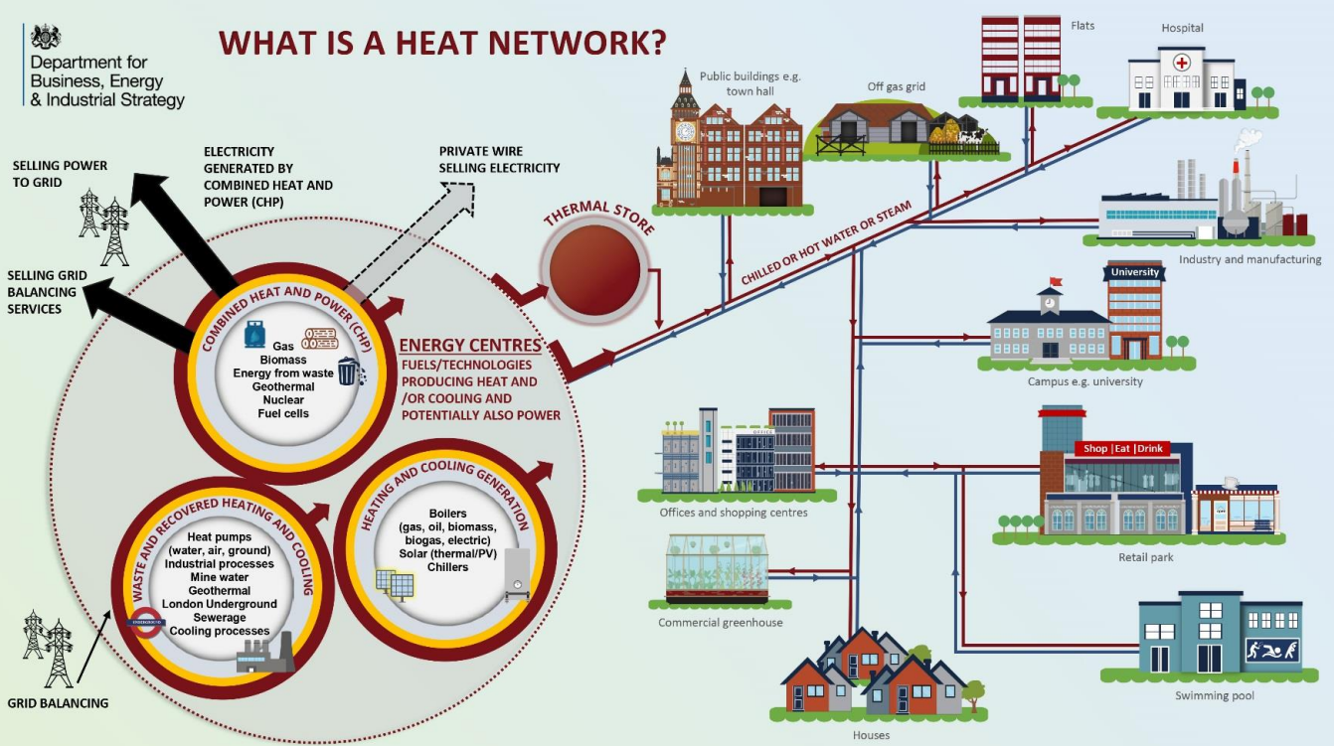
Delivering Together
A’ Lìbhrigeadh Còmhla
What is a network?
https://assets.publishing.service.gov.uk/media/5abccf5f40f0b6026d7ecefb/HNIP_What_is_a_heat_network.pdf

Slide 4
Delivering Together
A’ Lìbhrigeadh Còmhla
Benefits of Heat Networks
Environmental Benefits
Reduction in carbon emissions
Reduced air pollution
Economic Benefits
Job creation
Long-term energy savings
Social Benefits
Energy equity
Enhanced community resilience
Reduced heating costs for consumers
Energy price stability
Improved public health

Slide 5
Delivering Together
A’ Lìbhrigeadh Còmhla
Heat Networks (Scotland) Act 2021
Introduced the regulatory framework for heat networks in Scotland (partially in force).
Statutory targets for deployment of heat networks: Equivalent to 3%, 8% and 9% of current heat demand.
Building Assessment Reports (“BAR”): Scottish public authorities have an obligation to prepare a BAR to assess suitability of non-domestic properties for connecting to heat networks.
Heat Network Zones: Local authorities have an obligation to review area to consider if it is likely to be “particularly” suitable for construction or operation of a heat network and decide if area should be designated as “heat network zone”.
Consent regime (not yet in force): There will be a requirement to obtain consent from the “consent authority” (a role to be undertaken by the Scottish Ministers or relevant local authority) to build and operate a heat network in Scotland.
Licensing (not yet in force): All heat networks will need a licence to operate in Scotland which will give heat network developers certain rights and powers and OFGEM will be the “licensing authority”.
Heat Network Permits (not yet in force): Heat network operators may need to obtain a permit to build and operate a network in a designated zone (on an exclusive access basis).
Heat in Buildings Bill (Scottish Gov confirmed this will be introduced): This will include powers to require public sector buildings to connect to district heating when available.

Slide 6
Delivering Together
A’ Lìbhrigeadh Còmhla
National Heat Network Targets
Statutory targets:
2027: 2.6 TWh of thermal energy output
2030: 6 TWh of thermal energy output
2035: 7 TWh of thermal energy output

Slide 7
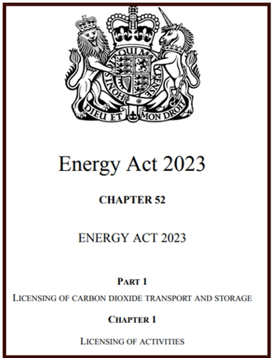
Delivering Together
A’ Lìbhrigeadh Còmhla
Energy Act 2023
UK legislation introducing a BG-wide heat network authorisation regime, coming into elect from 2026.
Authorisation:
Administered by Ofgem
Mandatory for all heat networks, with exemptions
Granted subject to fitness checks
Apply conditions covering consumer protection (reserved law), and technical standards
Also introduced England-only heat network zones.

Slide 8
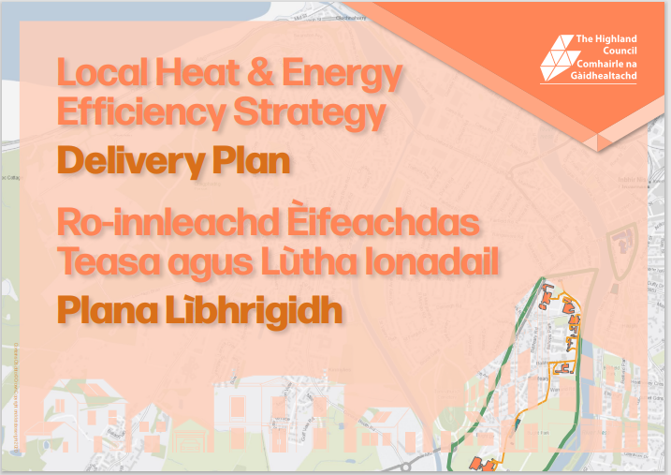
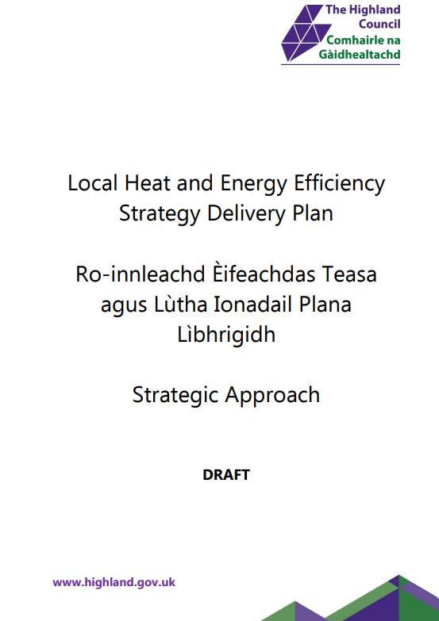
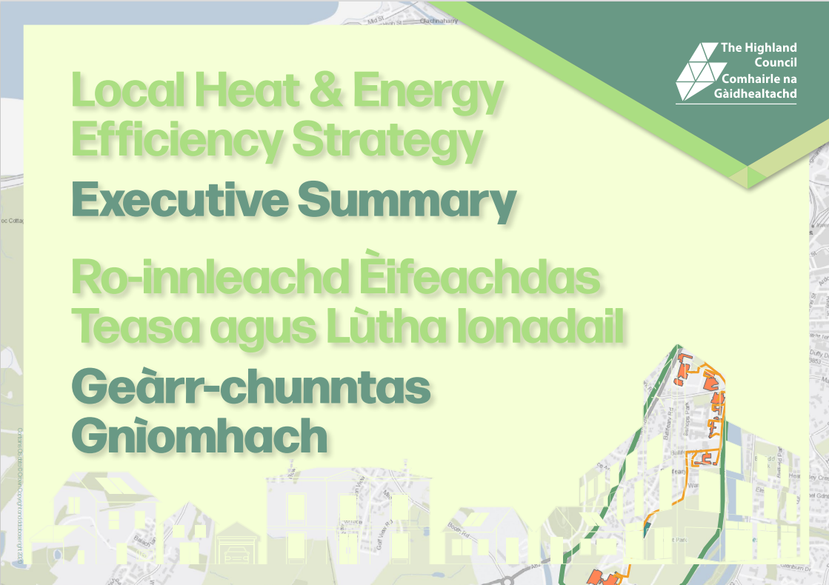
Delivering Together
A’ Lìbhrigeadh Còmhla
Local Heat and Energy Efficiency Strategy
The Local Heat and Energy Efficiency Strategies (Scotland) Order 2022 places a legal duty on all 32 Scottish local authorities to prepare a local heat and energy efficiency strategy and delivery plan by the end of December 2023.
The Council published the first iteration of the Strategy and Delivery Plan in December 2023.
LHEES sets a plan for decarbonising heat in buildings across the Highlands and improving their energy efficiency.

Slide 9
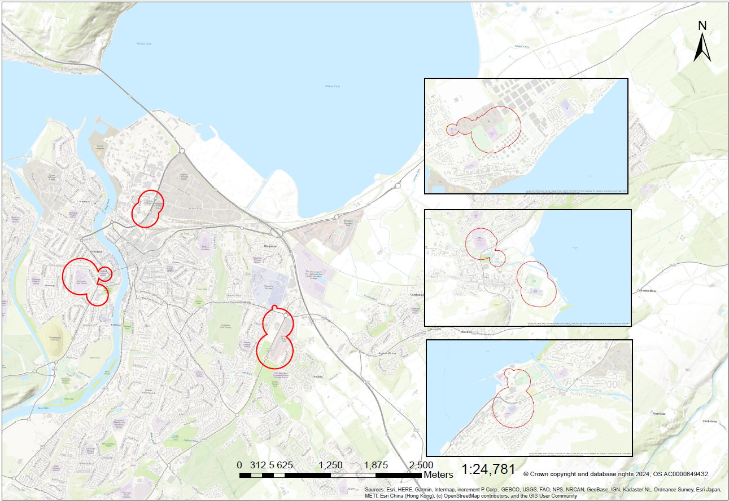
Delivering Together
A’ Lìbhrigeadh Còmhla
Potential Heat Network Zones

Slide 10
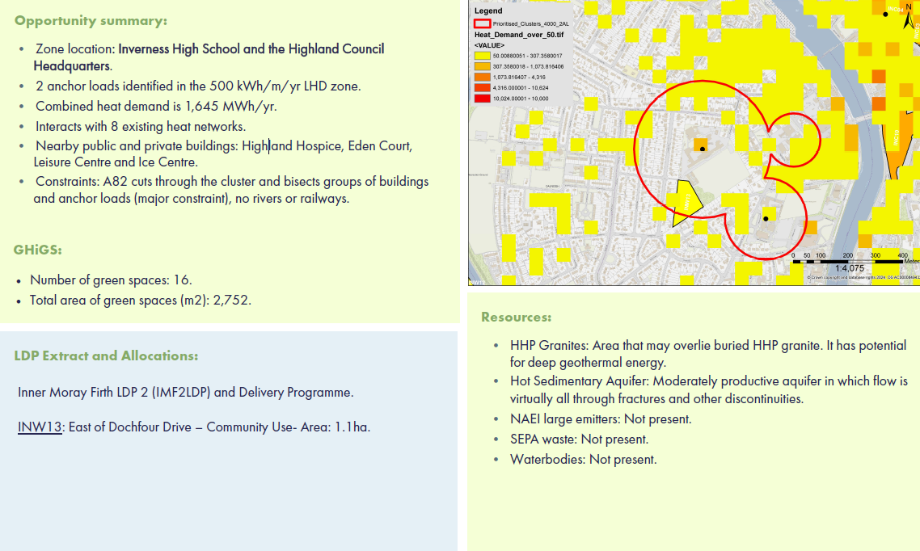
Delivering Together
A’ Lìbhrigeadh Còmhla
Opportunity Summary

Slide 11
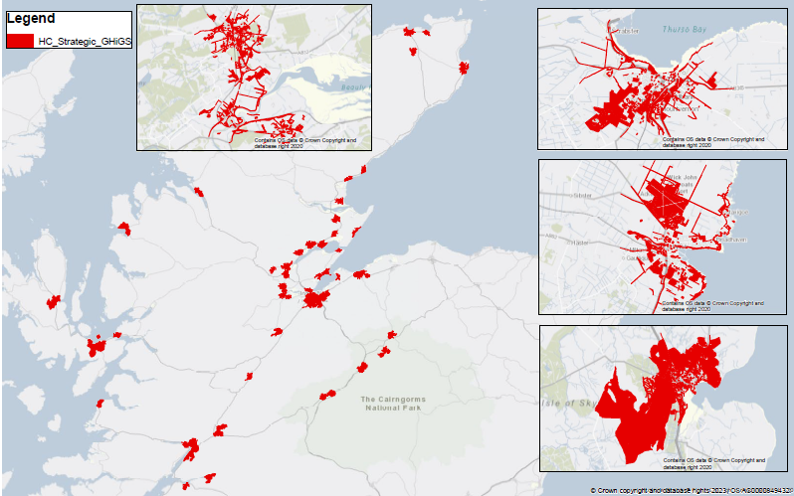
Delivering Together
A’ Lìbhrigeadh Còmhla
Wider Heat Network Opportunity

Slide 12
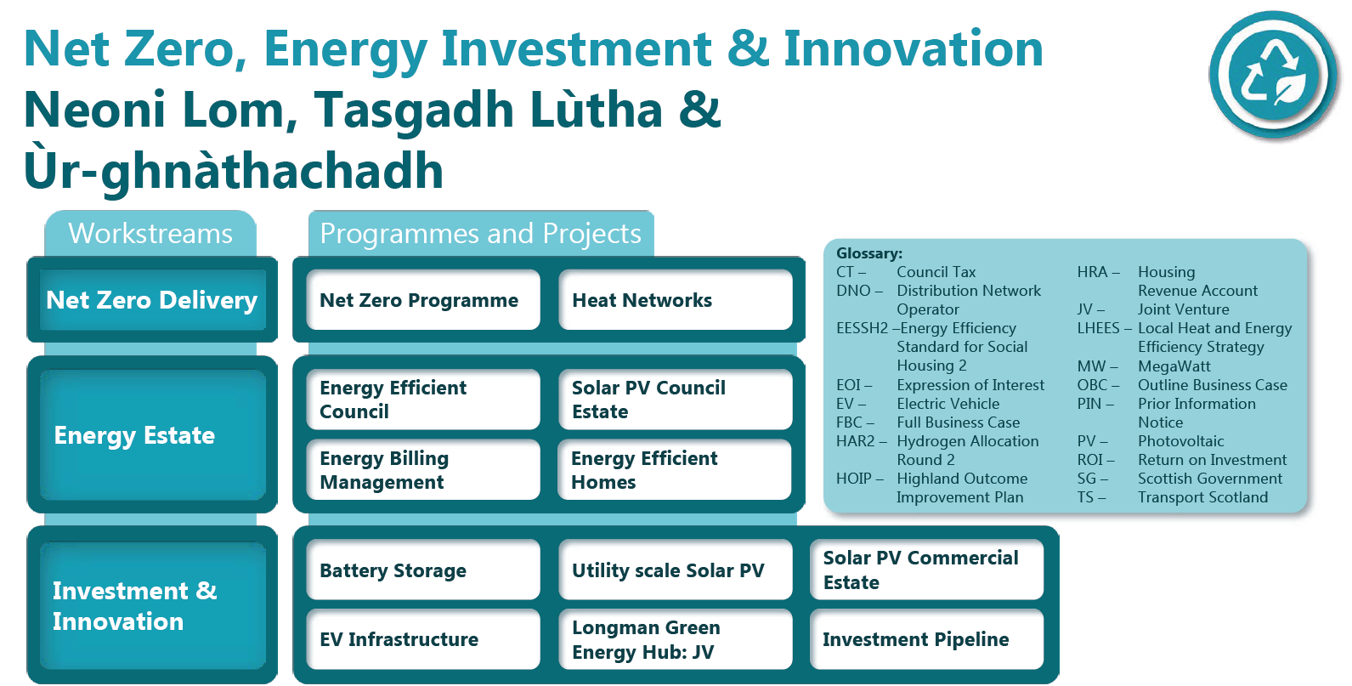
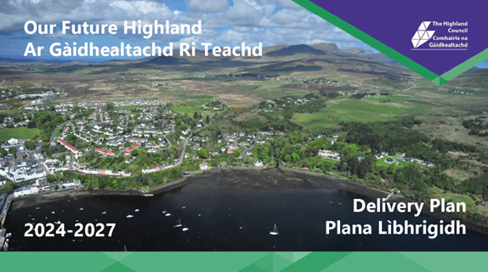
Delivering Together
A’ Lìbhrigeadh Còmhla
Net Zero, Energy Investment & Innovation

Slide 13
Delivering Together
A’ Lìbhrigeadh Còmhla
Funding and Support
Pre-capital: Heat Network Support Unit (HNSU)
Purpose: Offers support and grant funding for the pre-capital stages of project development.
Support: Provides assistance for feasibility studies, outline business cases, and strategic heat network support for local authorities.
Capital: Scotland’s Heat Network Fund (SHNF)
Purpose: Provides capital co-funding to accelerate the delivery of affordable, reliable, and clean heat from heat networks.
Funding: A £300 million commitment to support the rollout of zero-emission heat networks.

Slide 14
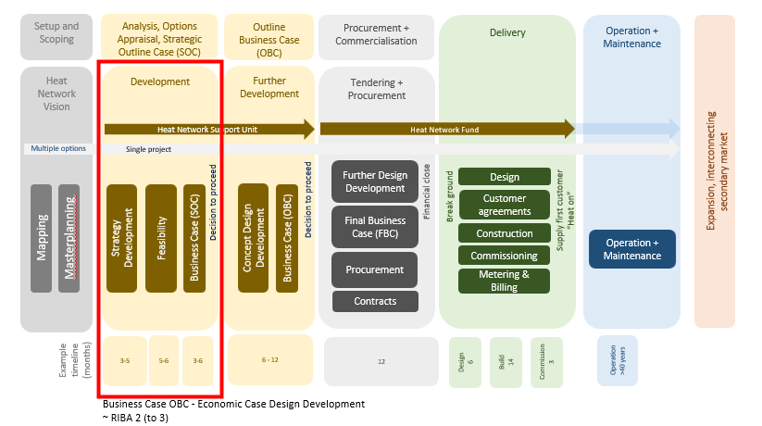
Delivering Together
A’ Lìbhrigeadh Còmhla
Project Development Process

Slide 15
Delivering Together
A’ Lìbhrigeadh Còmhla
Objectives of the Project
Carbon Reduction: Supports Scotland and THC’s Net Zero target by 2045 through sustainable heating.
Energy Efficiency: Provides reliable, efficient heat to lower energy consumption.
Local Energy Security: Reduces reliance on fossil fuels by using renewable and local sources.
Lower Consumer Costs: Delivers affordable heating via economies of scale.
Economic Growth: Creates jobs and stimulates local development through infrastructure investment.

Slide 16
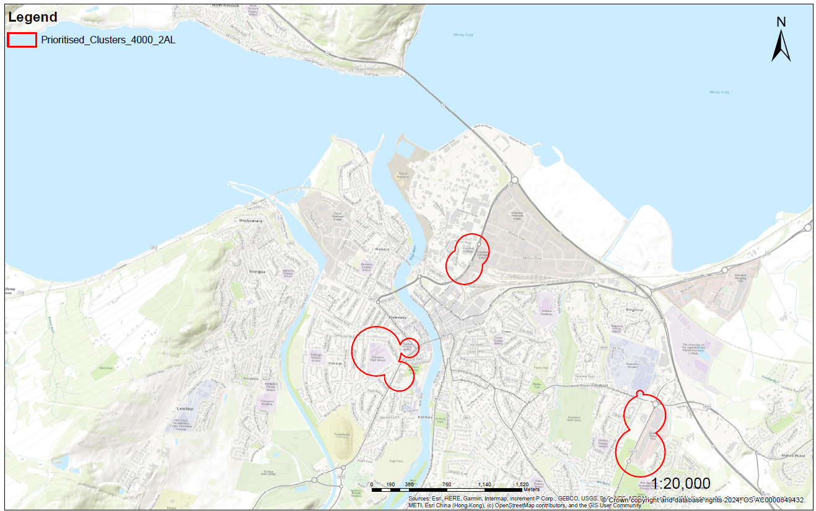
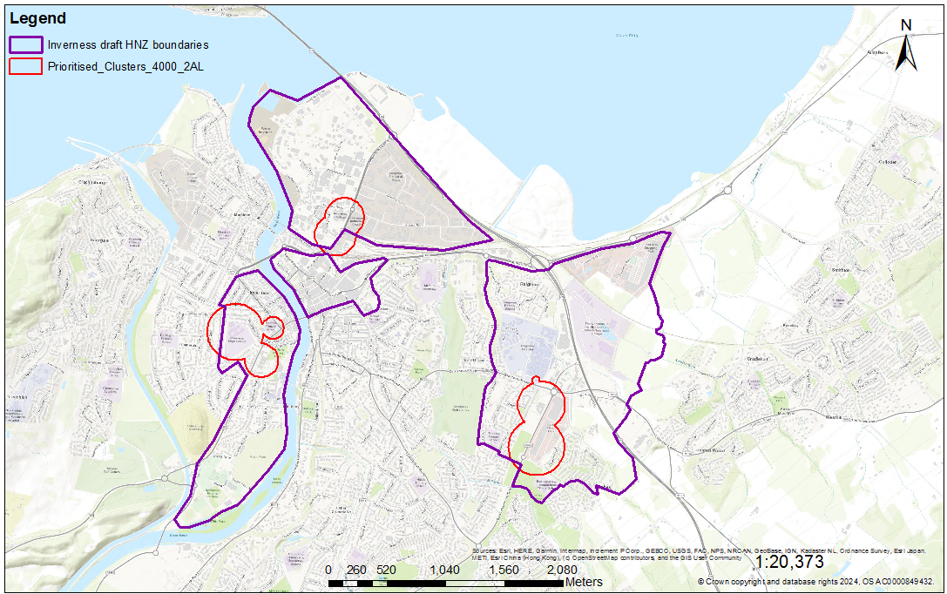
Delivering Together
A’ Lìbhrigeadh Còmhla
Inverness
Potential Heat Network Zones in Inverness
Inverness Strategic Feasibility Study Boundary

Slide 17
Delivering Together
A’ Lìbhrigeadh Còmhla
West Bank Assessment Criteria
Assessment criteria | Core network | Core and infill
Total demand (MWh/yr) | 24,015 | 33,213
Network length (m) | 5,200 | 9,500
LHD (MWh/yr/m) | 4.6 | 3.5
Planned growth in the area | Low | Low
Council land (share) % | 46.80 | 46.80
Dig type (hard) % | 58 | 64
Number of anchor loads (>=500MWH/yr) | 13 | 13
Number of connected buildings | 23 | 94
Number of Council buildings | 8 | 14
Number of public sector buildings | 8 | 12
Fuel poverty (mean) % | 29 | 29
Count of properties with fuel poverty probability over 50% | 162 | 162
Total social housing | 419 | 419

Slide 18
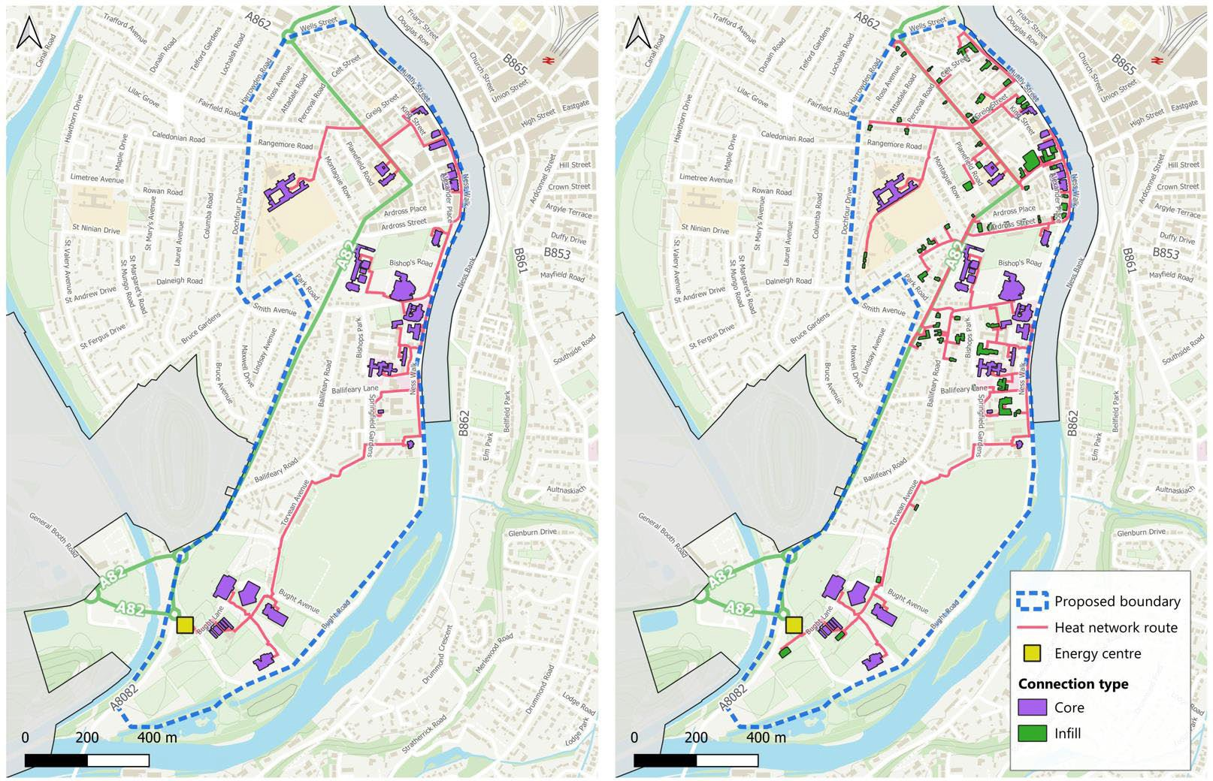
Delivering Together
A’ Lìbhrigeadh Còmhla
West Bank Indicative Heat Network
Base map OS Crown Copyright

Slide 19
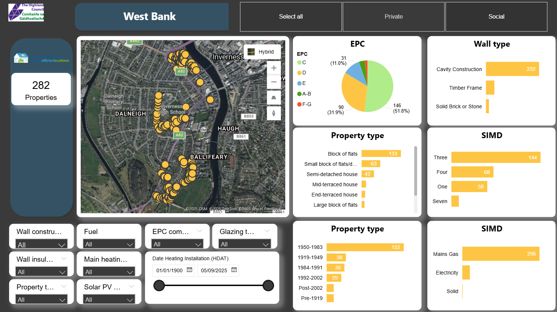
Delivering Together
A’ Lìbhrigeadh Còmhla
West Bank

Slide 20
Delivering Together
A’ Lìbhrigeadh Còmhla
City Centre
Assessment criteria | Core | Core and infill
Total demand (MWh/yr) | 21,540 | 35,000
Network length (m) | 2.7 | 6.4
LHD (MWh/yr/m) | 7.77 | 5.57
Planned growth in the area | Moderate/High | Moderate/High
Council land (share) % | 9.70 | 9.70
Dig type (hard) | 67 | 67
Number of anchor loads (>=500MWh/yr) | 16 | 16
Number of connected buildings | 17 | 107
Number of Council buildings | 2 | 3
Number of public sector buildings | 1 | 12
Fuel poverty (mean) | 36 | 36
Count of properties with fuel poverty probability over 50% | 44 | 44
Total social housing | 153 | 153

Slide 21
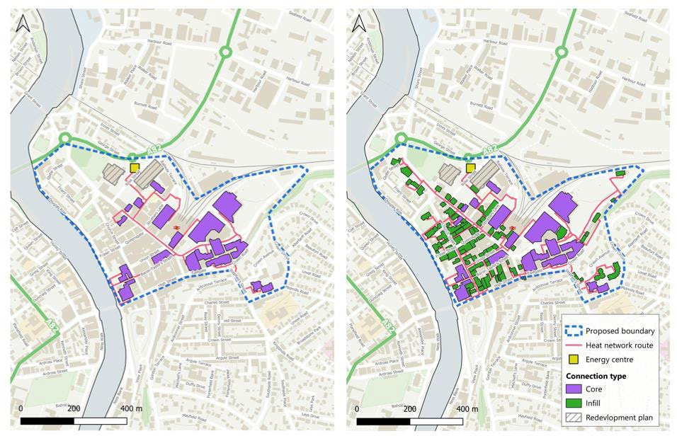
Delivering Together
A’ Lìbhrigeadh Còmhla
City Centre Indicative Heat Network
Base map OS Crown Copyright

Slide 22
Delivering Together
A’ Lìbhrigeadh Còmhla
Longman (Core)
Assessment criteria | Longman Full | Longman Full + Bairds | Longman West | Longman West + Bairds
Linear heat density | 2 | 7.4 | 1.97 | 11.61
Council land (share) | 38.30% | 38.30% | 44.30% | 44.30%
Planned growth in the area | Low | Low | Low/Moderate | Low/Moderate
Dig type (hard) | 67% | 67% | 67% | 67%
Number of anchor loads (>=500MWh/yr) | 12 | 13 | 6 | 7
Number of core connections | 14 | 15 | 6 | 7
Number of connected buildings | 14 | 15 | 6 | 7
Number of Highland Council buildings | 0 | 0 | 0 | 0
Number of public sector buildings | 4 | 4 | 2 | 2

Slide 23
Delivering Together
A’ Lìbhrigeadh Còmhla
Longman (Core and Infill)
Assessment criteria | Longman Full | Longman Full + Bairds Malting | Longman West | Longman West + Bairds
Linear heat density | 2.15 | 5.2 | 2.37 | 10.22
Council land (share) | 38.30% | 38.30% | 44.30% | 44.30%
Planned growth in the area | Low | Low | Low/Moderate | Low/Moderate
Dig type (hard) | 67% | 67% | 67% | 67%
Number of anchor loads (>=500MWh/yr) | 12 | 13 | 6 | 7
Number of core connections | 14 | 15 | 6 | 7
Number of connected buildings | 47 | 48 | 16 | 17
Number of Highland Council buildings | 3 | 3 | 1 | 1

Slide 24
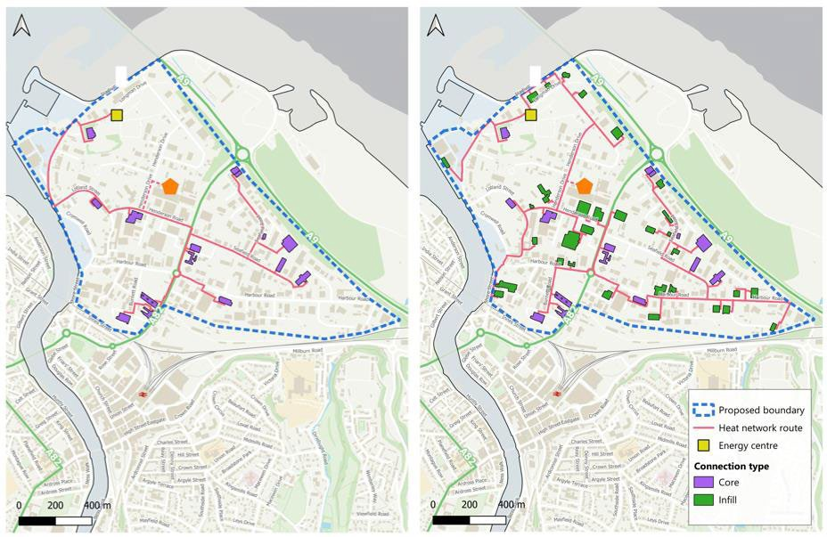
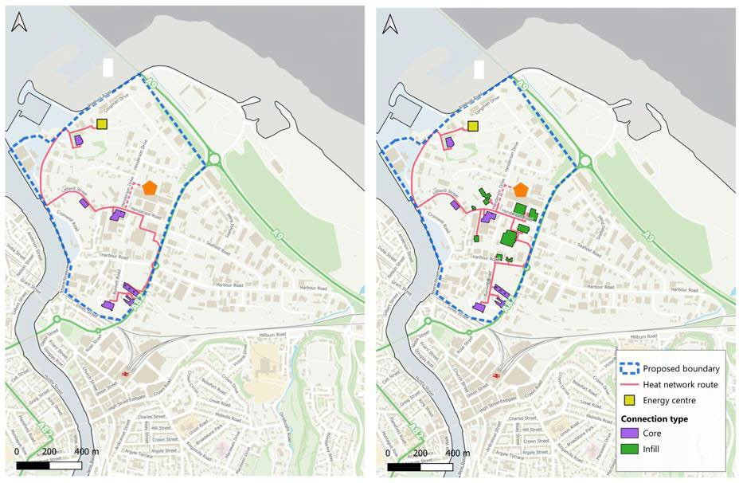
Delivering Together
A’ Lìbhrigeadh Còmhla
Longman Indicative Heat Network
Base map OS Crown Copyright
Base map OS Crown Copyright
Full Longman area indicative heat network
West Longman area indicative heat network

Slide 25
Delivering Together
A’ Lìbhrigeadh Còmhla
Raigmore
Assessment criteria | Raigmore full | Raigmore West | Raigmore East
Annual heat demand (MWh/y) | 48,750 | 28,000 | 20,750
Trench length (m) | - | 5,220 | 4,500
Linear heat density | 5.02 | 5.4 | 4.6
Council land (share) | 12% | 18% | 1%
Planned growth in the area | Moderate/High | Moderate/High | High
Dig type (hard) | 91% | 100% | 81%
Number of anchor loads (>=500MWh/yr) | 20 | 8 | 12
Number of core connections | 38 | 15 | 23
Number of connected buildings | 38 | 15 | 23
Number of THC buildings | 4 | 4 | 0
Number of public sector buildings | 24 | 6 | 18

Slide 26
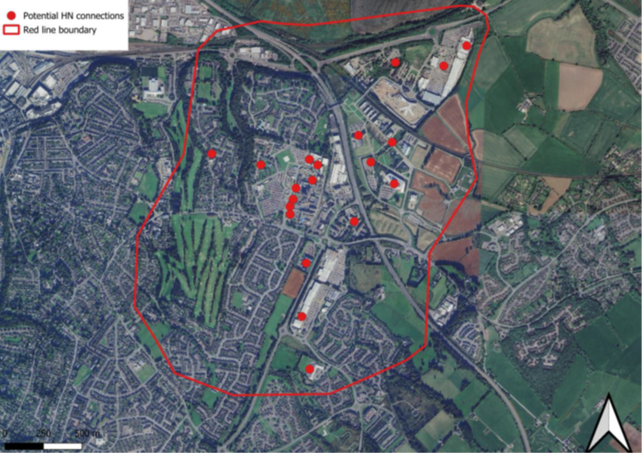
Delivering Together
A’ Lìbhrigeadh Còmhla
Raigmore Indicative Heat Network
Raigmore West Network
Base map OS Crown Copyright
Raigmore East Network
Base map OS Crown Copyright

Slide 27
Delivering Together
A’ Lìbhrigeadh Còmhla
Technology Assessment Summary
Technologies Potential
Air Source Heat Pumps (ASHPs)
Ground Source Heat Pumps (GSHPs)
Biomass
Wastewater Source Heat Pumps (WSHPs)
Back-Up Solution:
Gas boilers
Electric boiler
Thermal Storage:
Attractive option to support heat demand across the network
Energy Centre Considerations:
Multiple potential locations identified
Selected location should:
Be close to low-grade heat source
Be near anchor loads of the network

Slide 28
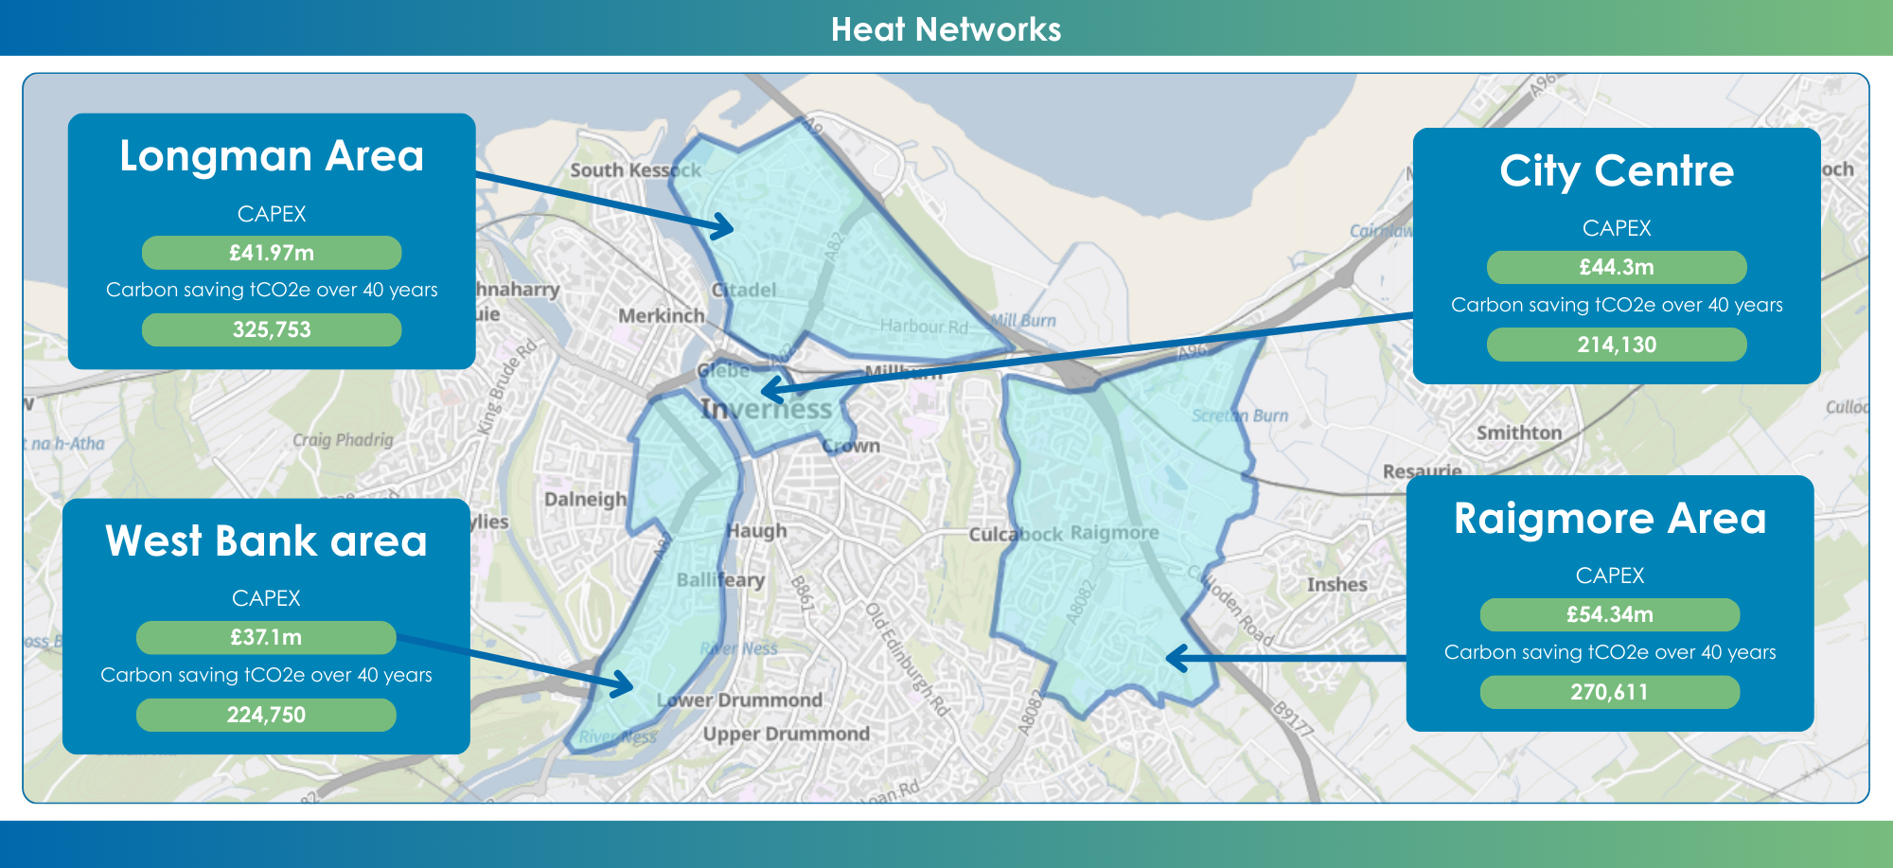
Delivering Together
A’ Lìbhrigeadh Còmhla
Cost and Savings
Base map OS Crown Copyright

Slide 29
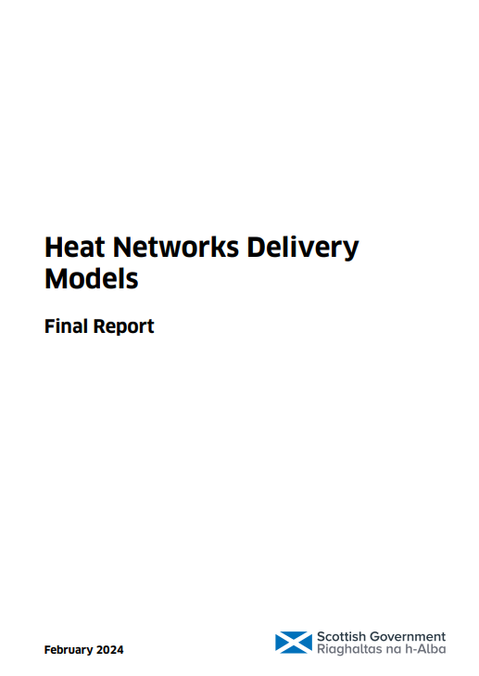
Delivering Together
A’ Lìbhrigeadh Còmhla
Delivery Models
Public sector led
Concession
Joint Venture between local authority and private sector
This report, prepared by Scottish Futures Trust (SFT) for the Scottish Government in May 2023, assesses the potential roles that a range of delivery models (alongside a number of complementary enabling structures / mechanisms) could play in helping to accelerate the pace and scale of heat network deployment.
It makes recommendations on interventions Scottish Government could make in relation to certain models.

Slide 30
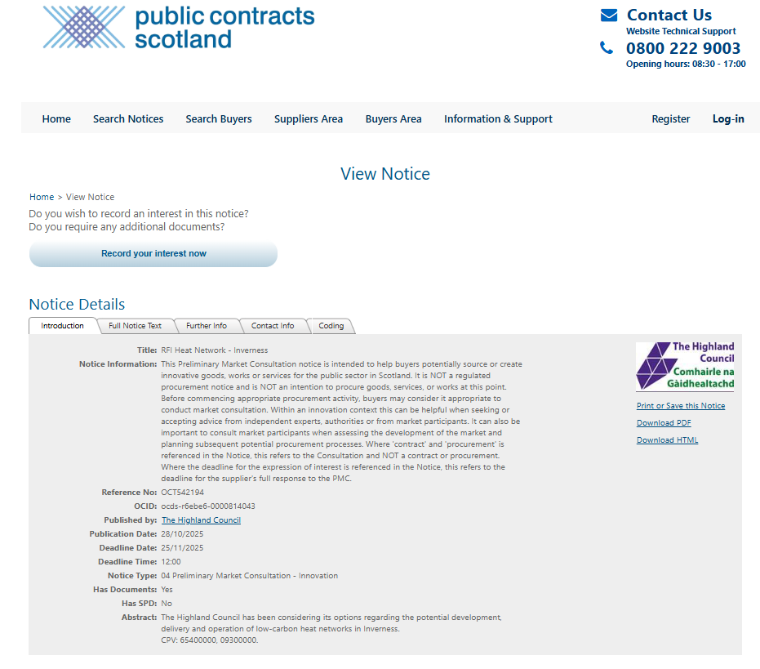
Delivering Together
A’ Lìbhrigeadh Còmhla
Request for Information (RFI)
RFI Questions:
Delivery Model Preferences
Council Role
Public Investment and Subsidy
Location Preferences

Slide 31
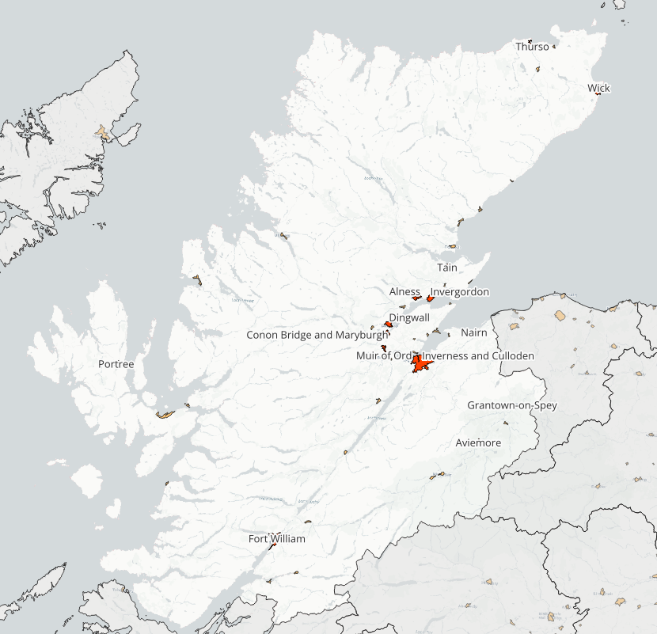
Delivering Together
A’ Lìbhrigeadh Còmhla
Wider Area Scan
Dingwall
Tain
Alness
Invergordon
Wick (specifically the north side of the river)
Aviemore

Slide 32
Delivering Together
A’ Lìbhrigeadh Còmhla
Next Steps
Member Engagement: Workshop held in November to brief Elected Members on progress and outline next steps.
Market Insight: Evaluation of the Request for Information (RFI) to gauge supplier interest and assess market readiness.
Ongoing Work:
Updating the Techno-Economic Model (TEM) for the West Bank area to inform development of the Outline Business Case (OBC).
Conducting a broader review across Highland Council areas to identify additional heat network opportunities aligned with LHEES.
Collaboration: Continuing engagement with the Scottish Government, local authorities, and key stakeholders to share best practice.
Business Case: Developing a Business Case for the Inverness Heat Network opportunity.

Slide 33
Delivering Together
A’ Lìbhrigeadh Còmhla
Contact Information
ruta.burbaite@highland.gov.uk
neil.osborne@highland.gov.uk
LHEES@highland.gov.uk

Slide 34
Delivering Together
A’ Lìbhrigeadh Còmhla
Useful Links
The Local Heat and Energy Efficiency Strategy and Delivery Plan
The Highland Council's Heat Network Feasibility Study Reports
The Highland Council's Heat Network Vision Statement
Heat Networks Delivery Models
Renewable and Low Carbon Energy: Heat Networks

Slide 35
Discussion

Slide 36
Thank You

