Slide 1
Capital Programme & Net Zero Funding
prògram calpa agus maoineachadh lom neoni
6th March 2023

Slide 2
What are we trying to change?
Structure of the Capital Programme
Governance of the Capital Programme
Intervention Stages in Capital Programme
Alignment in Capital Programme (across the public sector)
Investment Project Pipeline

Slide 3


Salix Recycling Fund

Slide 4
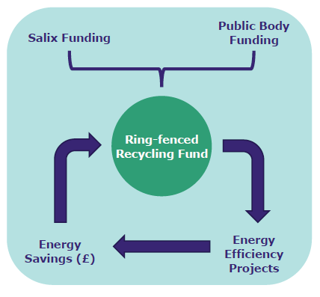
RF Model
Notes:
Emphasised Ring fenced fund, legal obligation to Salix

Slide 5
The key benefits to date
Estimated annual energy savings 4.4m kWh
Estimated annual carbon savings 1,200 tCO2e;
Estimated annual savings £0.5m
A match funding contribution of £3.5m from Salix at 0% interest;
Lifetime savings of over £13.5m

Slide 6
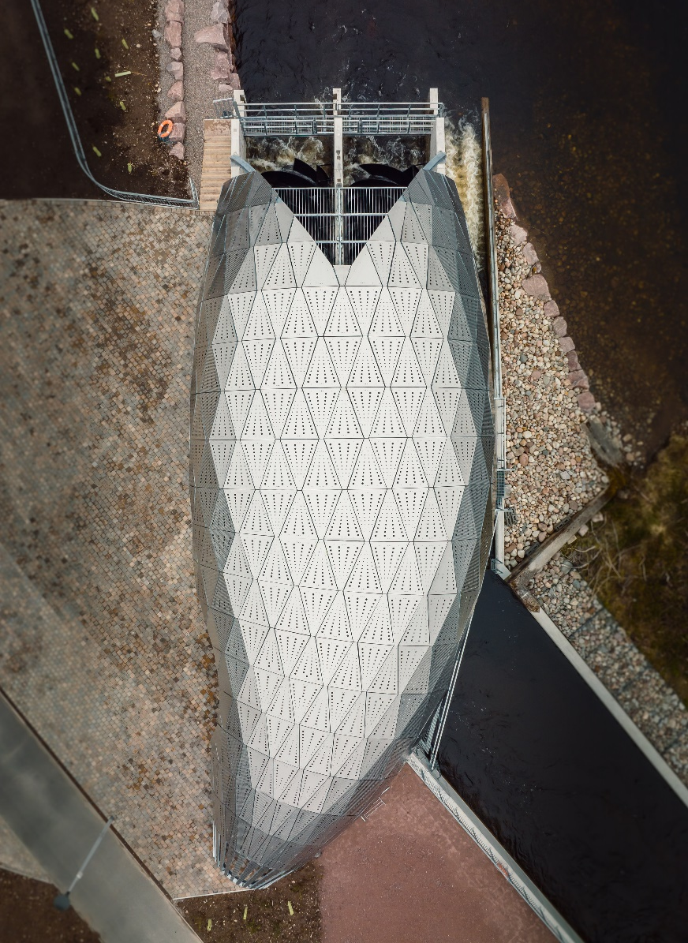
Hydro Ness
Award winning project
£1.05m contribution
£642k repaid over 16 years
£397k repaid over 12 years
Flagship project = flexibility in terms

Slide 7
Salix RF Overview
Current RF value: £12m
THC contribution: £4.75m
Salix contribution: £7.25m (interest free)
Potential spend 22/23: £728k
Projected spend 22/23: £759k
Potential Spend for 23/24: £1.1m
Notes:
ELT agreed that the June 2021 Phase 3 indicative investment wasn’t approved – superseded by the Sep 21 and March 22 investments (this contradicts the June 2021 council meeting minutes). Impacts upon continuity of delivery, changes in agreements needs to be flagged. What are the processes?
Working with a smaller pot – easier, more manageable but directly impacts scale of work (and related benefits).

Slide 8
What’s next?
Where will the ideas come from?
How do we align the RF with Capital plans?
Do we want to add more funds? i.e. scale up.
What will deliver reliable carbon & financial savings?
Notes:
Where does the fund sit?

Slide 9
Renewables Projects
Direct wire investment – the next Ness Hydro, Solar PVs (cf. North Ayrshire Council)
Commercial Investment – wind, solar, battery storage technology
Partnership Investment – with communities? Financial rules apply

Slide 10
Capital Expenditure
New Projects – how do they contribute? How do they “lock in” net zero aspirations? E.g. Corran ferry replacement
Investment in existing assets – e.g. Castle project, NMP, Bught
Fleet transition

