Slide 1
Net Zero Thematic Groups
Members Workshop
bùth-obrach buill lìon neoni
7th February 2023

Slide 2
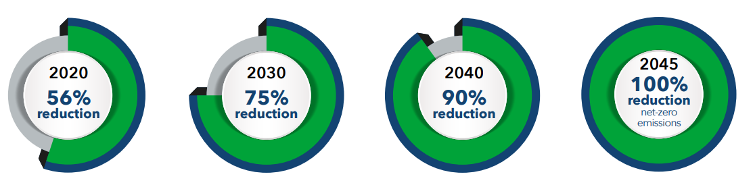
Scotland’s climate change legislation
2045
Net Zero

Slide 3
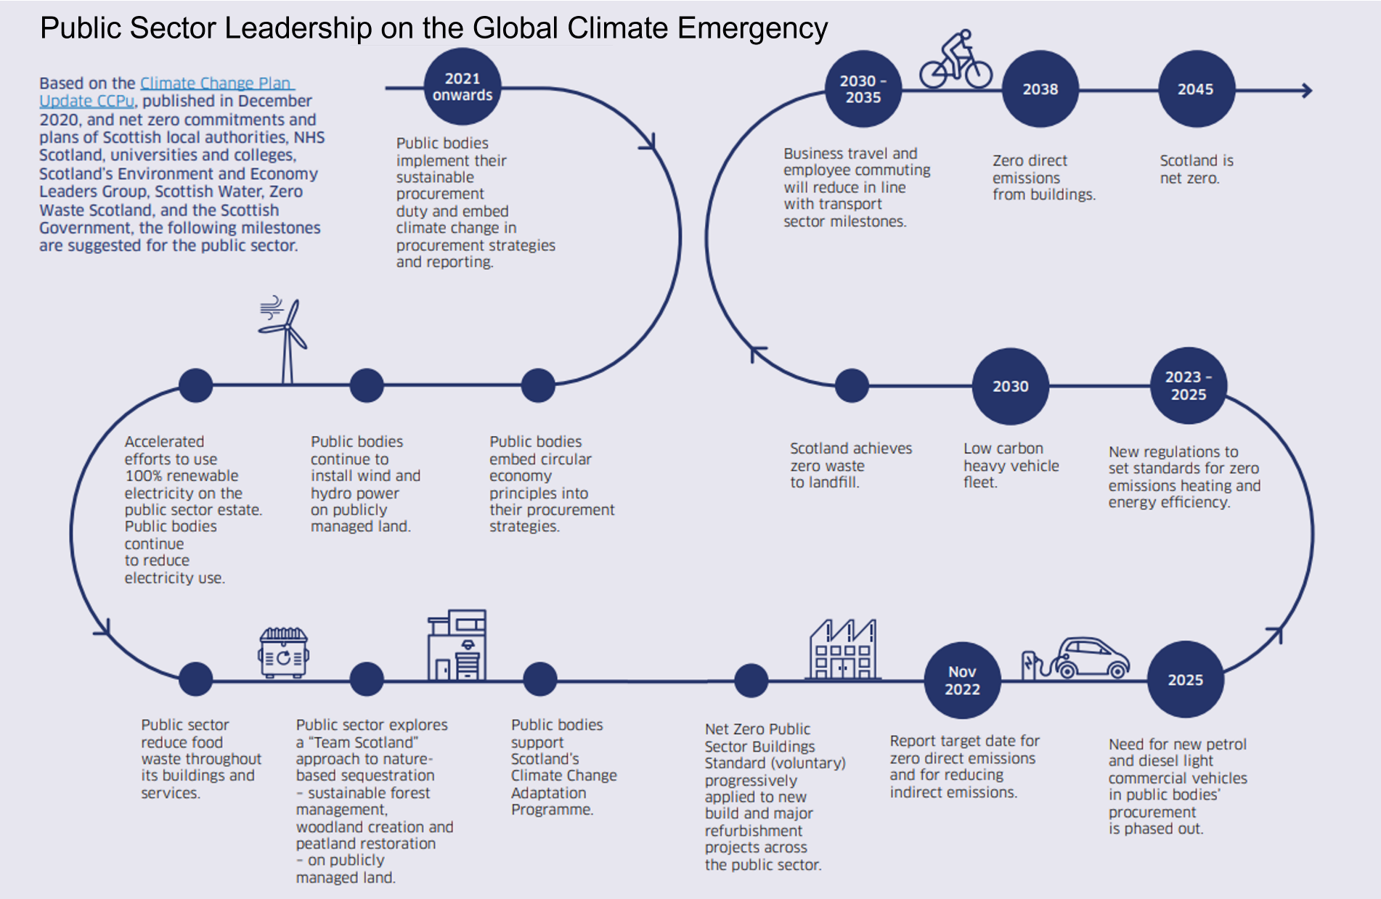

Slide 4
Reporting requirements
How the Council aligns its spending plans and use of resources to contribute to reducing emissions and delivering its emissions reduction targets.
Target date for achieving zero direct emissions of greenhouse gases.
Any targets for reducing indirect emissions of greenhouse gases i.e. emissions arising from our consumption of electricity.
How the Council is contributing to Scotland’s Adaptation Programme.

Slide 5
Resilience
Carbon Removal
Approach
Carbon Reduction
Mitigation
2022
2045
Adaptation

Slide 6
Programme Board
Social Housing HRA
Built Estate & Energy
Net Zero Strategy Group
Capital Programme & Net Zero Funding
Fleet & Staff Travel
Planning Land Use & Environment
Waste & Circular Economy
Procurement & Community Wealth Building

Slide 7
Timeline
Climate Change Committee workshop to be held during April to review high level strategy and route map; including setting of target dates
Climate Change Committee meeting, 17th May 2023
Develop fully costed action plan for consideration by Climate Change Committee on 5th December

Slide 8
Workshops
7th February, 10.00 – 17.00
Thematic Groups
10.30 - Social Housing/HRA estate
Lead: David Goldie, Head of Housing & Building Maintenance & Brian Cameron, Service Lead – Policy & Performance
13.45 - Fleet & Staff Travel
Lead: Caroline Campbell, Head of Operations & Logistics
15.15 - Procurement & Community Wealth Building
Lead: Andrew Collins, Strategic Procurement Manager
12.00 – Audit Scotland presentation and Q&A session

Slide 9
21st February, 10.00 – 17.00
Built Estate & Energy
Lead: Finlay MacDonald, Head of Property & Facilities Management
Waste & Circular Economy
Lead: Alan McKinnie, Strategic Lead for Waste Strategy & Operations
Planning, Land Use & Environment
Lead: Nicole Wallace, Service Lead Environment Development & Active Travel
Capital Programme & Net Zero Funding
Lead: Malcolm MacLeod, ECO Environment & Economy & interim depute Chief Executive
March (date and time to be confirmed)
Adaptation workshop

Slide 10
Audit Scotland
Scotland’s Councils’ Approach to Addressing Climate Change
Briefing calls on Local Authorities to consider the following recommendations:
Ensure clear and transparent emissions targets are in place
Increase action on adaptation and climate resilience
Make action plans clear about the gaps and challenges that remain
Increase collaboration efforts
Embed climate change into decision-making at all levels

Slide 11
Scottish Parliament's Net Zero, Energy and Transport Committee
The role of local government and its cross-sectoral partners in financing and delivering a net-zero Scotland
The Net Zero, Energy & Transport Committee wants to see clearer evidence of all Local Authorities planning strategically for net zero and ensuring that net zero goals and Council budgeting are aligned.
The Committee also calls on the Scottish Government to work with COSLA to audit the effectiveness of Councils’ net zero-related strategic planning and for Councils to ensure they "show their working" in their strategic plans, demonstrating how they propose to reach their targets.

Slide 12
Any questions?

