Slide 1
Internal Audit
Why, What and How?
Jason Thurlbeck
Corporate Audit Manager

Slide 2
The Myths about Internal Audit
Same as External Auditors
Corporate police, traffic wardens, inspectors
Don’t tell the Auditors
Audits are unnecessary
You’re an accountant it’s just about finance
Only here to report on known problems / failures
Audit requires you to do things ‘audit said’

Slide 3

The way I see my role
I’m not here to poke holes in our boat
I’m here to make sure we are not leaking
…...We are all in the same boat

Slide 4
The purpose of Internal Audit (GIAS)
Internal auditing strengthens the organisation’s ability to create, protect, and sustain value by providing the board and management with independent, risk-based, and objective assurance, advice, insight, and foresight.

Slide 5
Why?
Internal auditing enhances the Council’s:
• Successful achievement of its objectives.
• Governance, risk management, and control processes.
• Decision-making and oversight.
• Reputation and credibility with its stakeholders.
• Ability to serve the public interest.

Slide 6
What we do?
Independent and objective review of:
Risk Management
Control
Governance
Report this to Audit Committee
‘Reasonable Assurance’

Slide 7
What we Audit?
Audit Plan
Aligned to the Delivery Plan and Risks
Consulted CEO and the ACEs
Approved by the Audit Committee
It’s not a secret!

Slide 8
How? - The Audit Process
Planning
Fieldwork
Reporting
Follow Up

Slide 9
1. Planning
Audit context - background information
Service /area objectives and risks
explain the audit process in more depth
identify key contacts
request copies of key documents / management information to inform our work
Terms of Reference – Scope and Objectives

Slide 10
2. Fieldwork
Programme of work:
Understanding Council systems and processes
Testing / checking how systems and processes work in practice
Assessing the key controls in place to manage risks and the overall governance arrangements
Communicating – No surprises

Slide 11
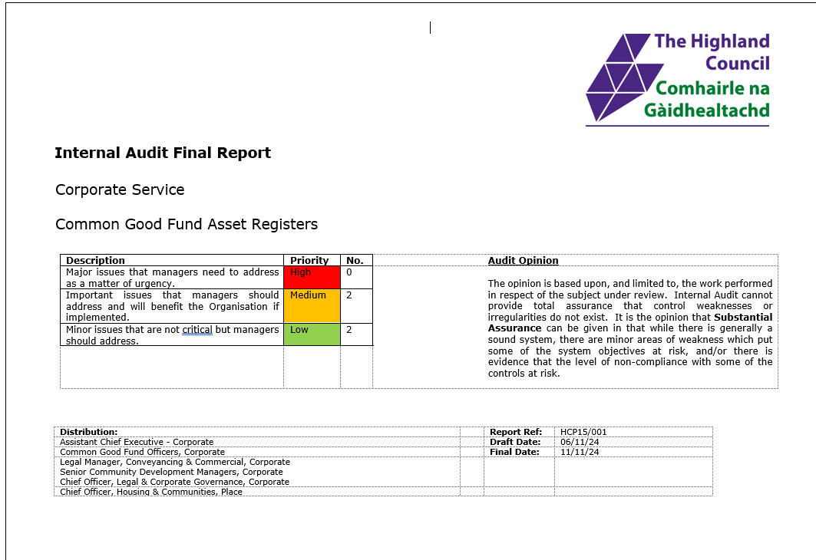
3. Reporting
Audit Opinion (Full, Substantial, Reasonable, Limited or No)
Our Findings
Recommendations
Action Plan – Management Actions not Internal Audits
Report to Audit Committee

Slide 12
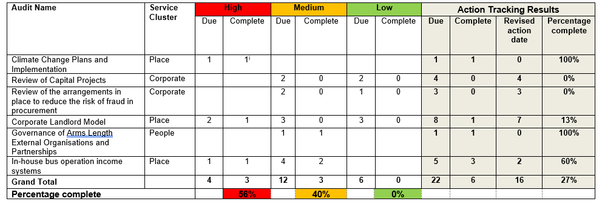
4. Follow Up
Action Tracking - Monitoring Improvement
Did Management do what they agreed to? Is it Complete?
Revised action dates
ACEs receive reports on all outstanding actions
Report to Audit Committee

Slide 13
Internal Audit helps the Council to
Reflect
Validate its approach
Identify improvements
Provide assurance that we are not leaking!
Any Questions?

