Slide 1
Audit Committee
Refresher training 05/02/25

Slide 2
Training aims
Our aims:
Enhance Committee Member's knowledge and understanding of role
Identify where we can support you further.
Your aims?
Notes:
My aims set out above.
Consider what your aims are.

Slide 3
Guidance for Audit Members
Appendix C – knowledge and skills framework for Audit Committee members.
Appendix E – self assessment of good practice.
Position Statement – sets out purpose, model, core functions and membership of the Audit Committee. “Expected to make best efforts to adopt these principles.”
Audit committees: practical guidance for local authorities and police (CIPFA 2022 edition). Includes:
Notes:
Position statement – separate document setting out CIPFA’s expectations. By adopting will ensure that audit committee is effective and statutory responsibilities (governance, internal controls, financial management and reporting and internal audit) are met.
Knowledge and skills framework covers core and specialist skills. Previously considered by Committee in a workshop on 22/08/23 as well as the self assessment. Will look to review and update these shortly.
Will provide copies of these to be added to the Members Intranet as well as these training slides.

Slide 4
Purpose of the Audit Committee
“Audit committees are a key component of an authority’s governance framework. Their purpose is to provide an independent and high-level focus on the adequacy of governance, risk and control arrangements. The committee’s role in ensuring that there is sufficient assurance over governance, risk and control gives greater confidence to all those charged with governance that those arrangements are effective.”
Notes:
Above taken from the Position Statement, highlighted key words. Previously referred to this in slide 3 earlier.

Slide 5
Core functions of an Audit Committee
Maintenance of governance, risk and control arrangements
Financial and governance reporting
Establishing appropriate and effective arrangements for audit and assurance
Notes:
Above set out by CIPFA in position statement, more detail provided in CIPFA publication

Slide 6
Audit Committee skills
Independent thinkers
Ability to challenge constructively
Curiosity
Wide knowledge of Council’s strategy and operations
Supportive of improvement
Awareness of financial matters
A focus on the wider environment and context- influences from outside
Keen to learn and develop understanding.

Slide 7
Core functions of an Audit Committee
In practice this means seeking assurance on:
Governance
Risk Management
Internal Control
Independent Assurance
Internal Audit
External Audit
External agencies
Management Assurance
Receive management reports and explanations
Notes:
Apply previous slide to detail HC arrangements

Slide 8
Assurances you will receive
Independent Assurance
Internal Audit:
Internal Audit Reports
Action tracking reports
Annual IA report with annual audit opinion
Fraud and whistleblowing annual report.
Annual Report - opinion on the financial statements, report to those charged with governance
Best Value reports.
External Audit:
Ombudsman
Ethical standards
Other inspections reports.
Reports from external organisations:

Slide 9
Assurances you will receive
Management Assurances
Annual assurance from Section 95 Officer.
Management update reports on audit actions
Annual Code of Corporate Governance
Risk Management update reports
Notes:
S95 officer assurance attached as a separate document to the EA report to those charged with governance.

Slide 10
An effective Audit Committee supports
• Awareness of internal control
• Prompt implementation of audit recommendations
• Greater emphasis on audit and risk matters
• Objective and fair financial reporting
• Process of independent and objective review
• Good corporate governance.

Slide 11
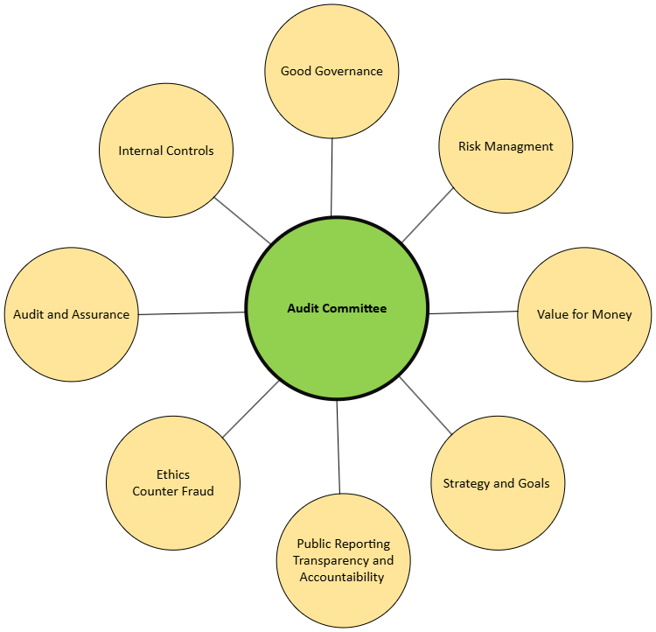
The influential Audit Committee
Notes:
This has been replicated from the CIPFA guidance – Audit Committee at the centre of everything. Appendix F in publication has a tool that can be used to measure the impact and effectiveness of the Committee.

Slide 12
Role of Audit Committee – reflections
How effective is the Committee in fulfilling its role?
What does the Committee do well?
What could be improved upon?
Are there any difficulties or challenges?
Next steps?
Notes:
What potential solutions are there to address any issues?
What support do they need from us?

Slide 13
For further information contact:
Donna.Sutherland@highland.gov.uk
Jason.Thurlbeck@highland.gov.uk

