Slide 1
Roads and Infrastructure Members Induction Day
Slide 01
Tuesday 24 May 2022

Slide 2
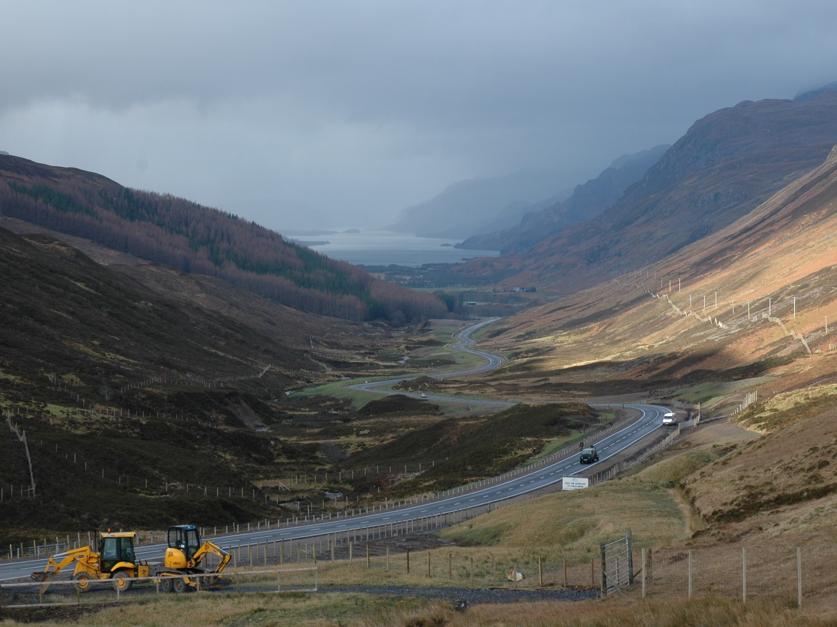
Slide 02

Slide 3

Infrastructure, Environment and Economy
Slide 03

Slide 4
Infrastructure, Environment and Economy
Slide 04
ECO, I, E &E
Malcolm MacLeod
Head Of Service
(Roads and Infrastructure)
(formerly Colin Howell)
Roads
Infrastructure

Slide 5
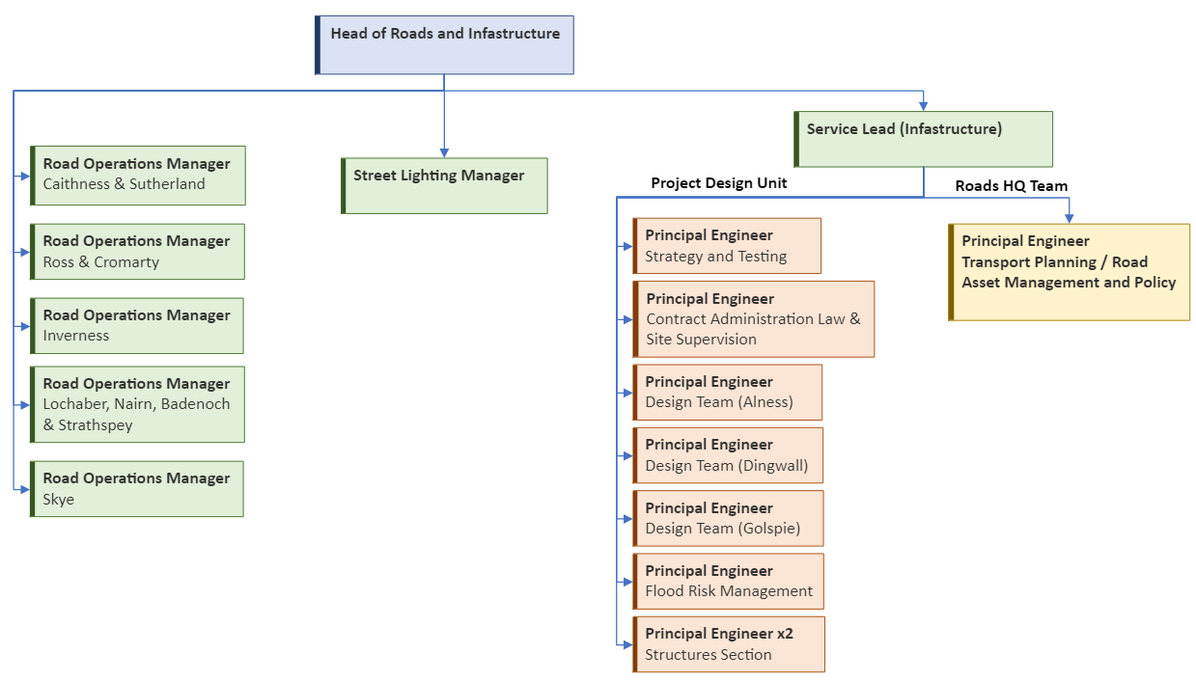
Roads & Infrastructure
Slide 05
Notes:
I am the service lead for Infrastructure (click) and have a separate teams of around 80 engineers, technicians and support staff who deliver a range of functions illustrated on the right hand side of this slide. John will take you through the roads functions on the left.

Slide 6
Slide 06
Infrastructure Teams
Service Lead (Infrastructure)
Garry Smith
Flood Team Dingwall
Led by Alan Fraser
Transport Planning and Asset Management, HQ
Led by Elizabeth Maciver
Structures Team 1 Alness
Led by Andrew Tryon
Design Team Dingwall and Alness
Led by Bryan Stout
Design Team Golspie
Led by Garry Smith
Design Team and Lab Diriebught, Inverness
Led by Andrew MacIver
Site Supervision Team Harbour Road, Inverness
Led by Murray Innes
Structures Team 2 Alness
Led by Simon Farrow

Slide 7
Areas of Work
Slide 07
Infrastructure Design and Construction
Consultation and Communication
Specialist Technical Advice
Flood Risk Management
Materials Testing Laboratory
Asset Management
Transportation Planning

Slide 8
Capital Infrastructure Delivery
Slide 08
Bridges & Road structures
Roads
Ferry Terminals
Landfill sites
Coastal protection
Flood Schemes
Burial Grounds
Cycling, Walking and Public Transport
Adapting our Roads Network

Slide 9
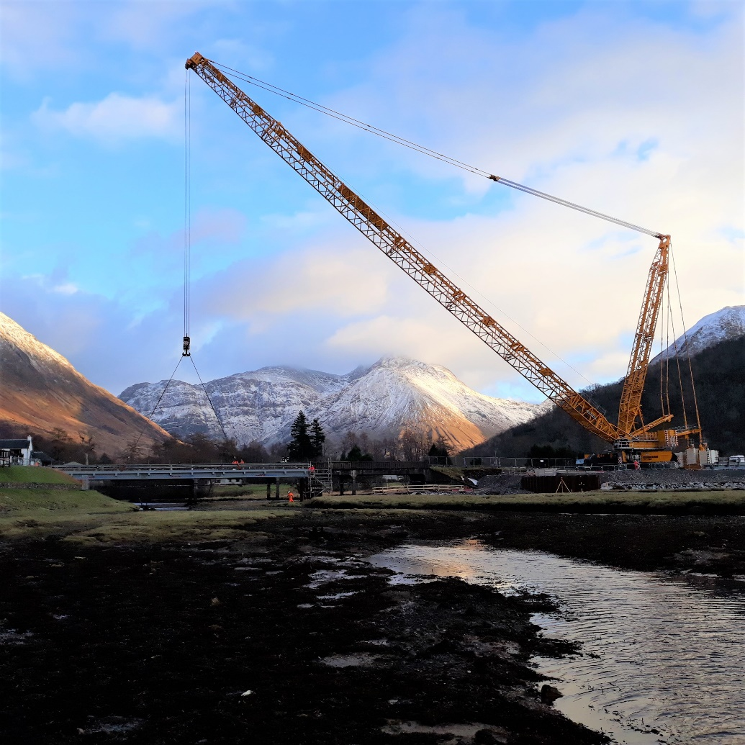
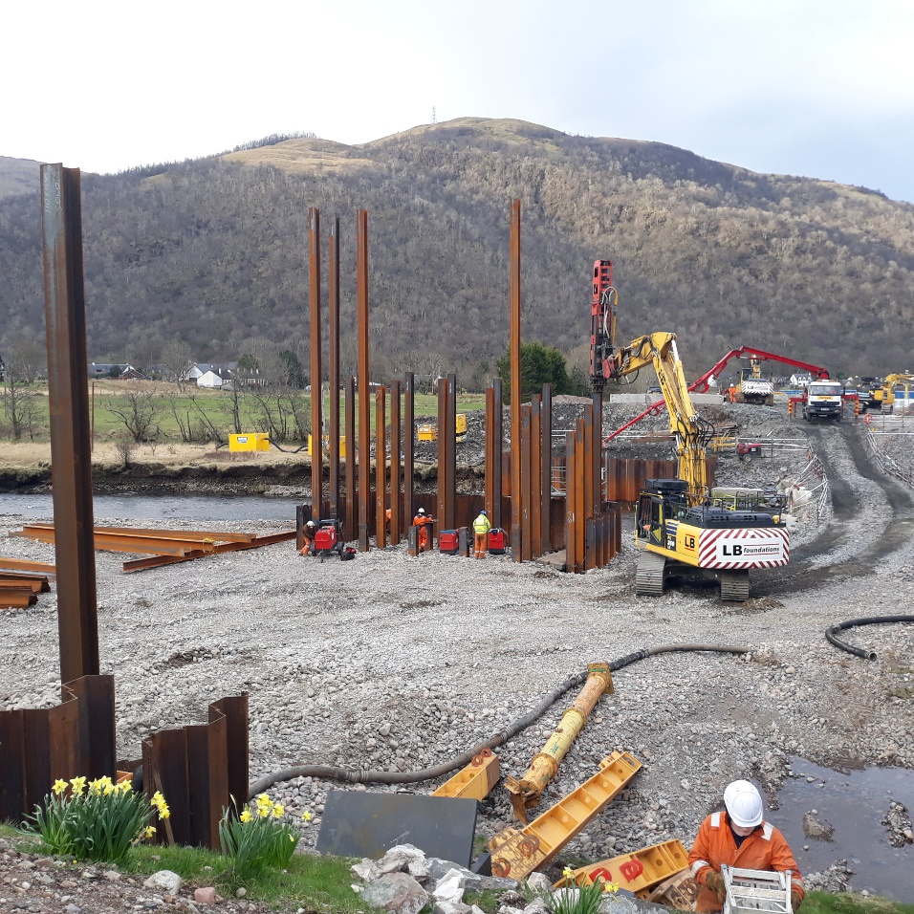
Capital Infrastructure Delivery
Slide 09

Slide 10
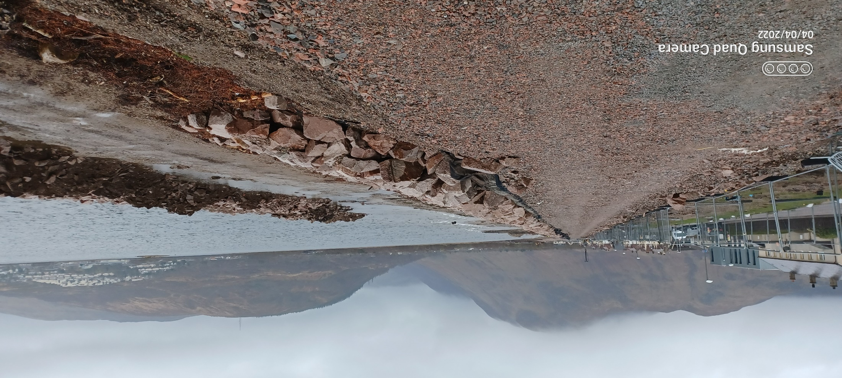
Capital Infrastructure Delivery
Slide 10

Slide 11
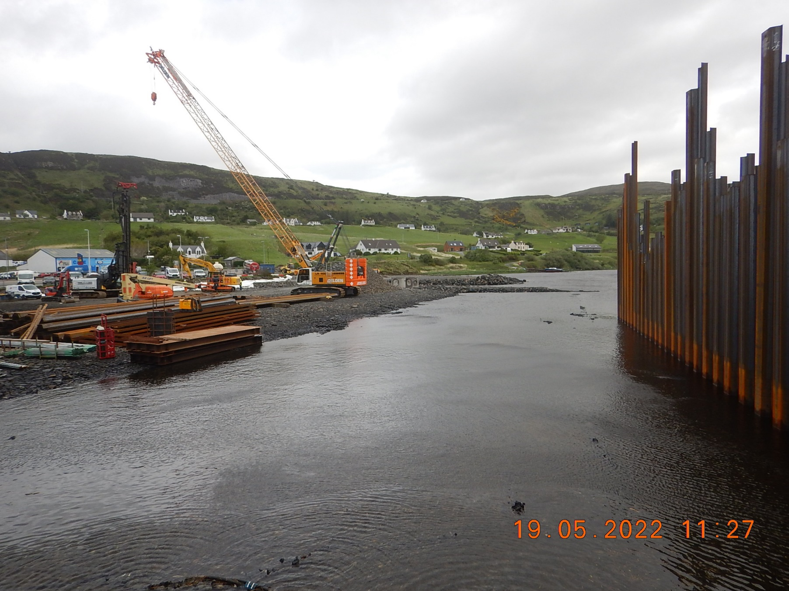
Capital Infrastructure Delivery
Slide 11

Slide 12
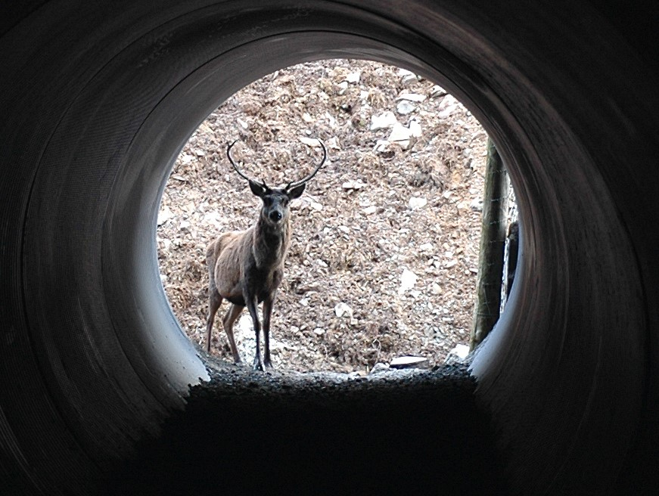
Slide 12

