Slide 1

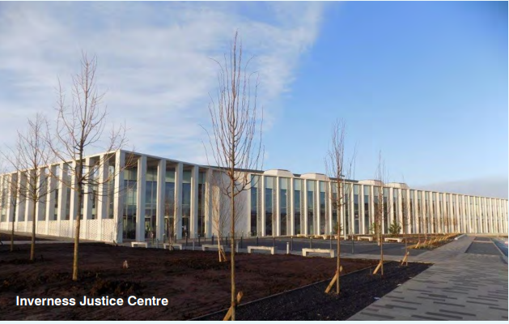
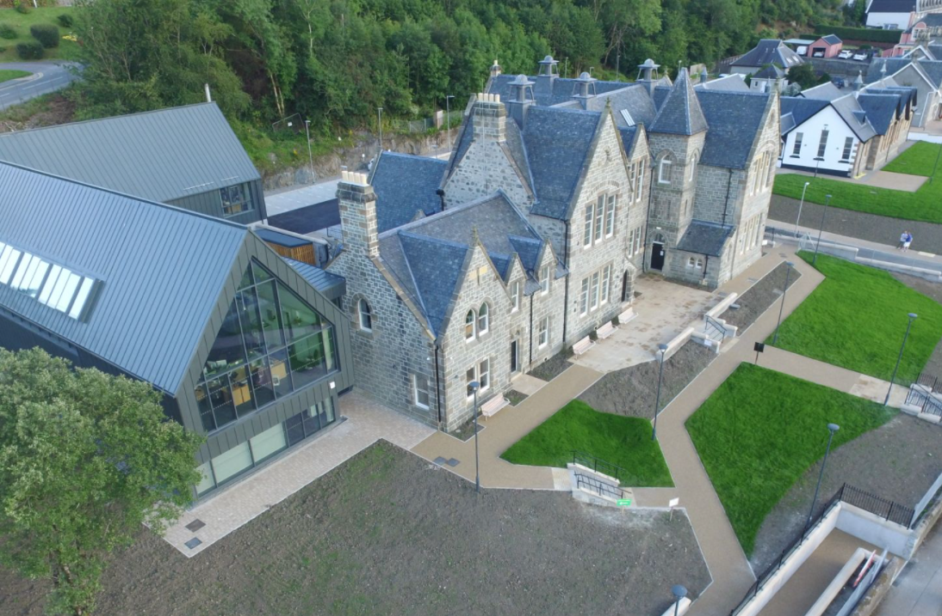
What do we do?
Provide advice to prospective applicants
Deal with planning applications
Monitor and discharge conditions
Deal with enforcement issues and complaints

Slide 2

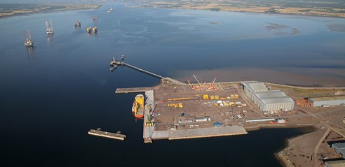
Development Management Functions
Area Planning
Strategic Projects
Aquaculture
Enforcement

Slide 3
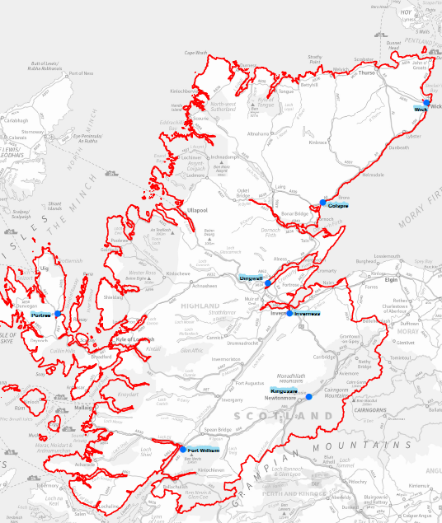
7 area offices
HQ

Slide 4
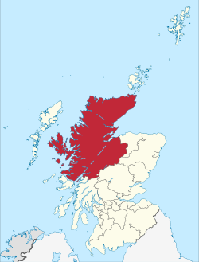
Largest Authority in Scotland & UK
Highest number of applications in Scotland
10% of all planning applications in Scotland
96% approval rate
96% under delegation
Notes:
The largest authority in Scotland and the UK
Biggest Planning Authority In Scotland –
Average 2,500 per annum
roughly 10% of applications in Scotland with less than 5% of population
96 % approval rate
95% dealt with under our scheme of delegation

Slide 5
Some numbers….
2018/19 we determined 2500 planning applications
2021/22 we determined 3207 planning applications.
96% were approved – granted planning permission
We dealt with 546 enforcement complaints
96 applications were refused last year of which 79 were delegated decisions
Notes:
74% of local pre-apps issued within 6 weeks and 100% of major development pre-applications within 4 weeks

Slide 6
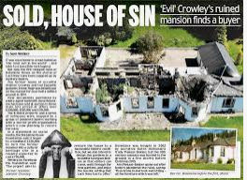
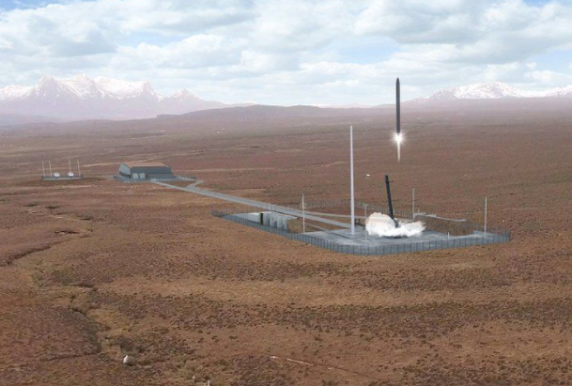
Choices
Applicants
Objectors
Pressure Groups
Emotive
Challenging
Rewarding
Rational & irrational

Slide 7
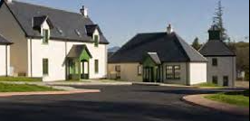
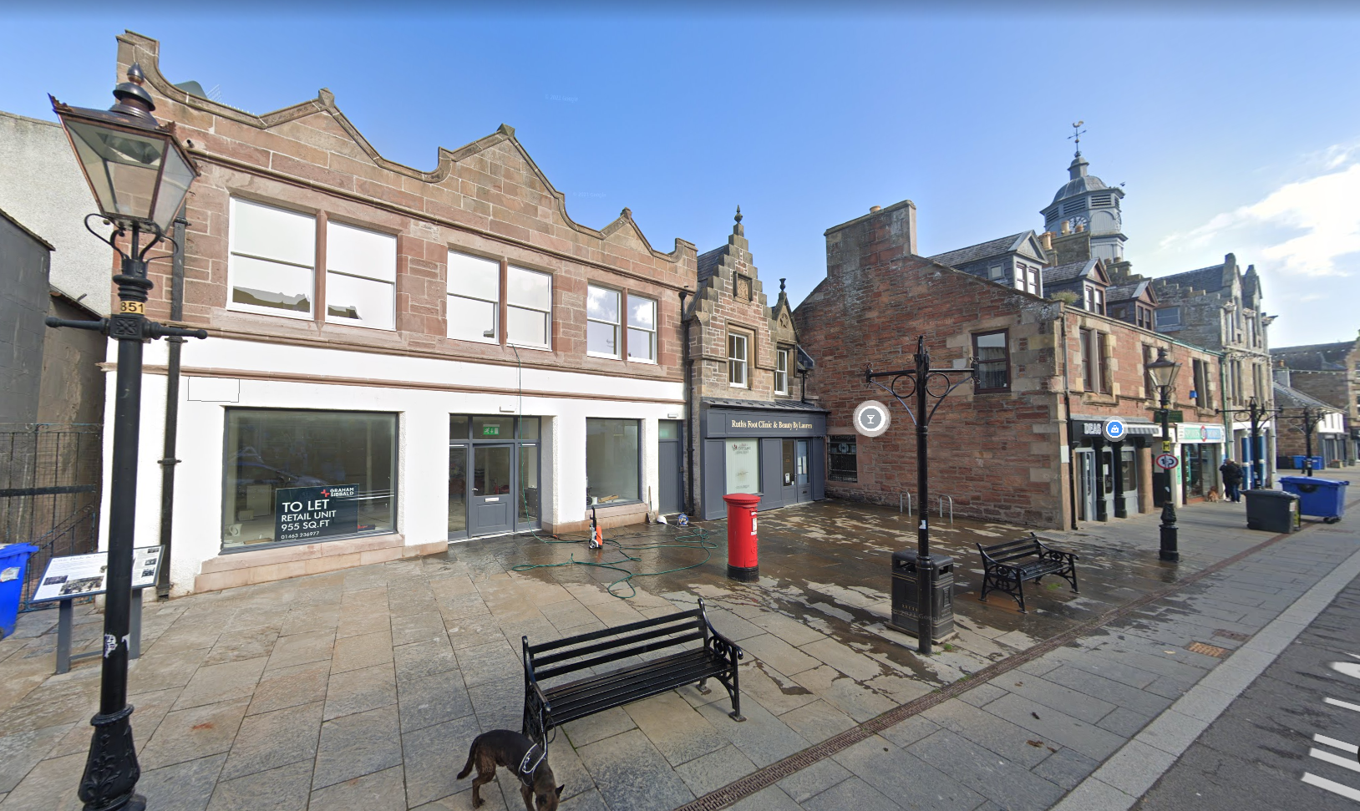
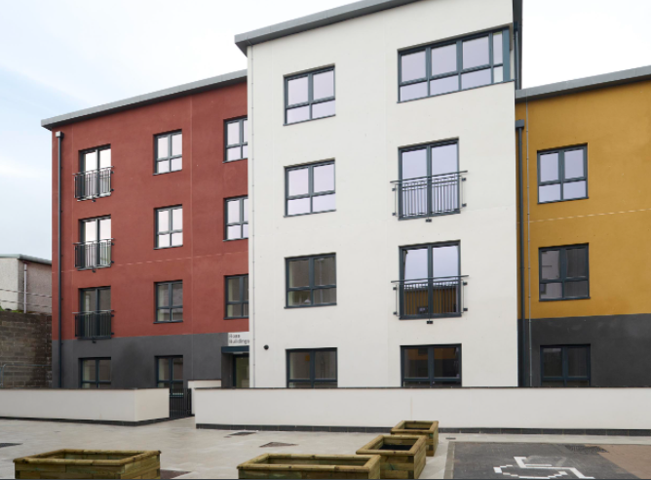
Tracking a Planning Application
Every week, a “weekly list” is emailed of every planning application (of all types) which have been submitted within your ward.
you can use the e-planning system to get further details.
If you have queries or questions contact the case officer
you have the option to request a planning application be referred to committee within 14 days of the weekly list being published – it requires 2 local members for this to occur.

Slide 8
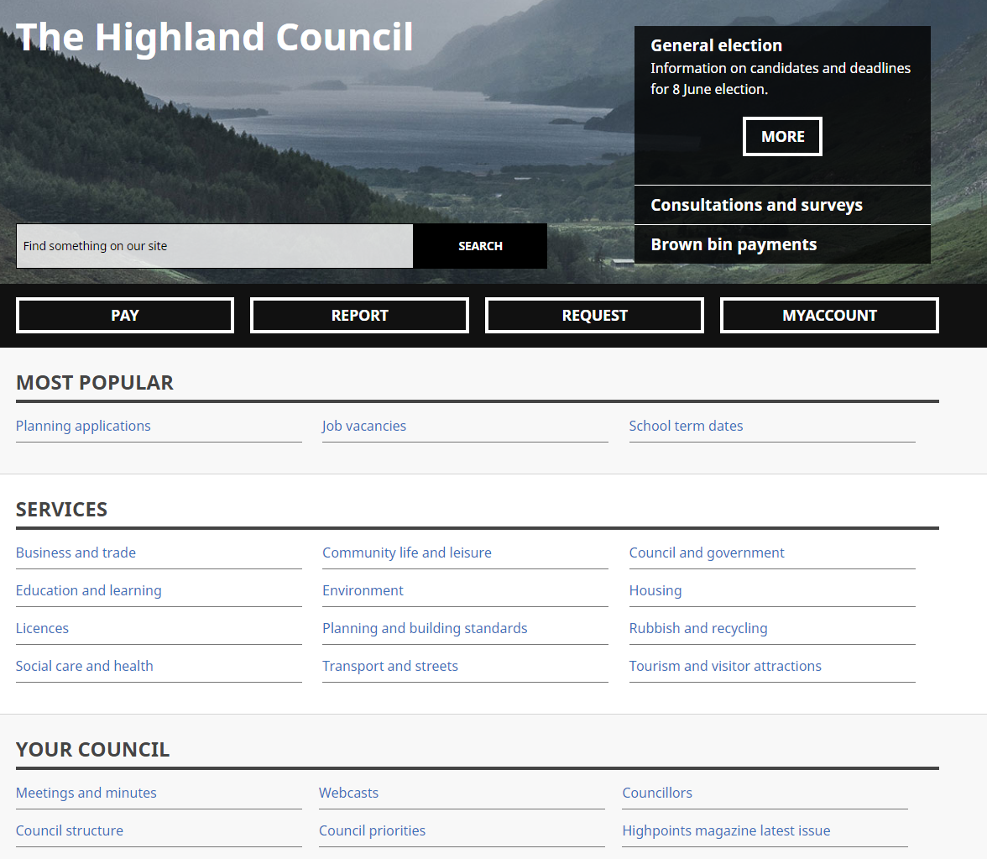

Slide 9
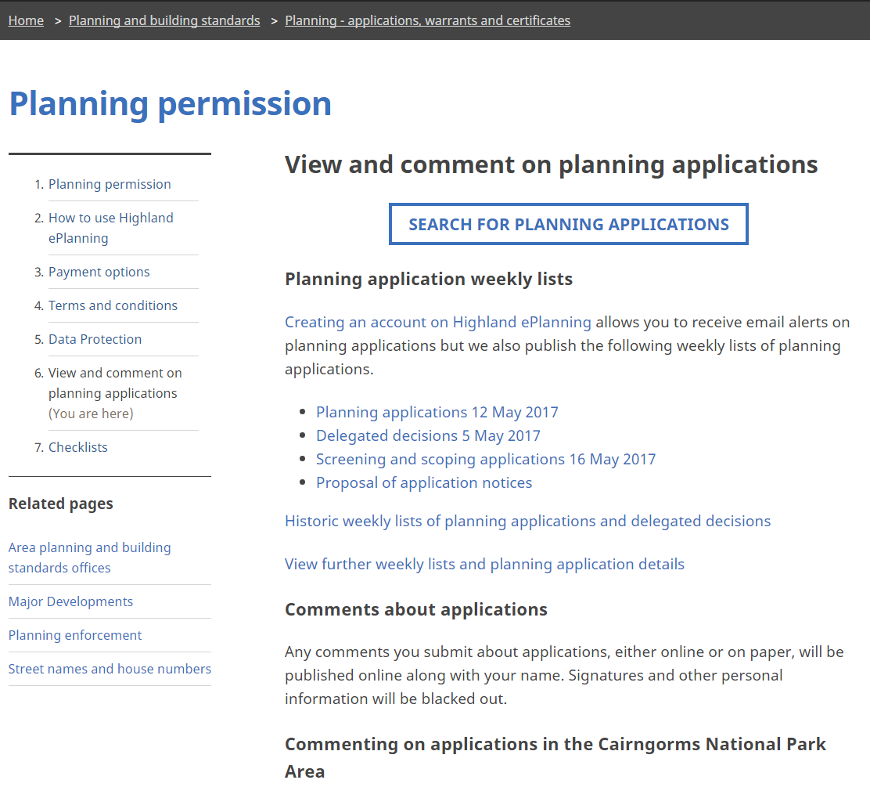

Slide 10
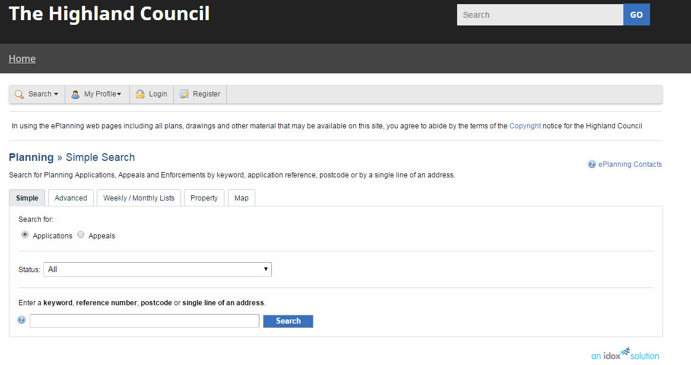

Slide 11
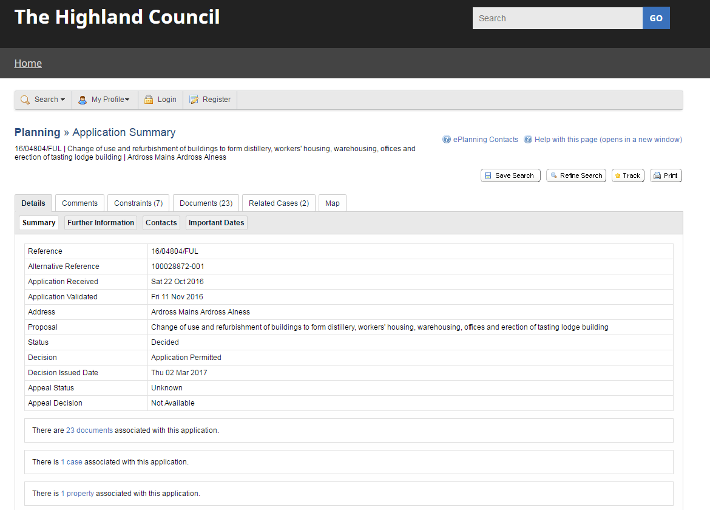

Slide 12
Delegated Refusals - Procedure
An e-mail will be sent to notify you with a copy of the report of handling.
5 working day to respond with the option either :
  To request the application comes to Committee
  To agree to the delegated refusal
Must not discuss or copy in your reply to colleagues
All responses are uploaded onto the web site
If 2 or more request referral it will go to committee

Slide 13
Scheme of Delegation - referred to committee when :
More than 5 objections from 5 or more separate addresses where recommended for approval
An unresolved objection from a statutory consultee which is recommended for approval
Delegated refusals referred by 2 or more ward members
All Major applications recommended for approval
Hosing developments of 30 or more
Manager’s discretion
Section 36’s
Application lodged by a member

Slide 14

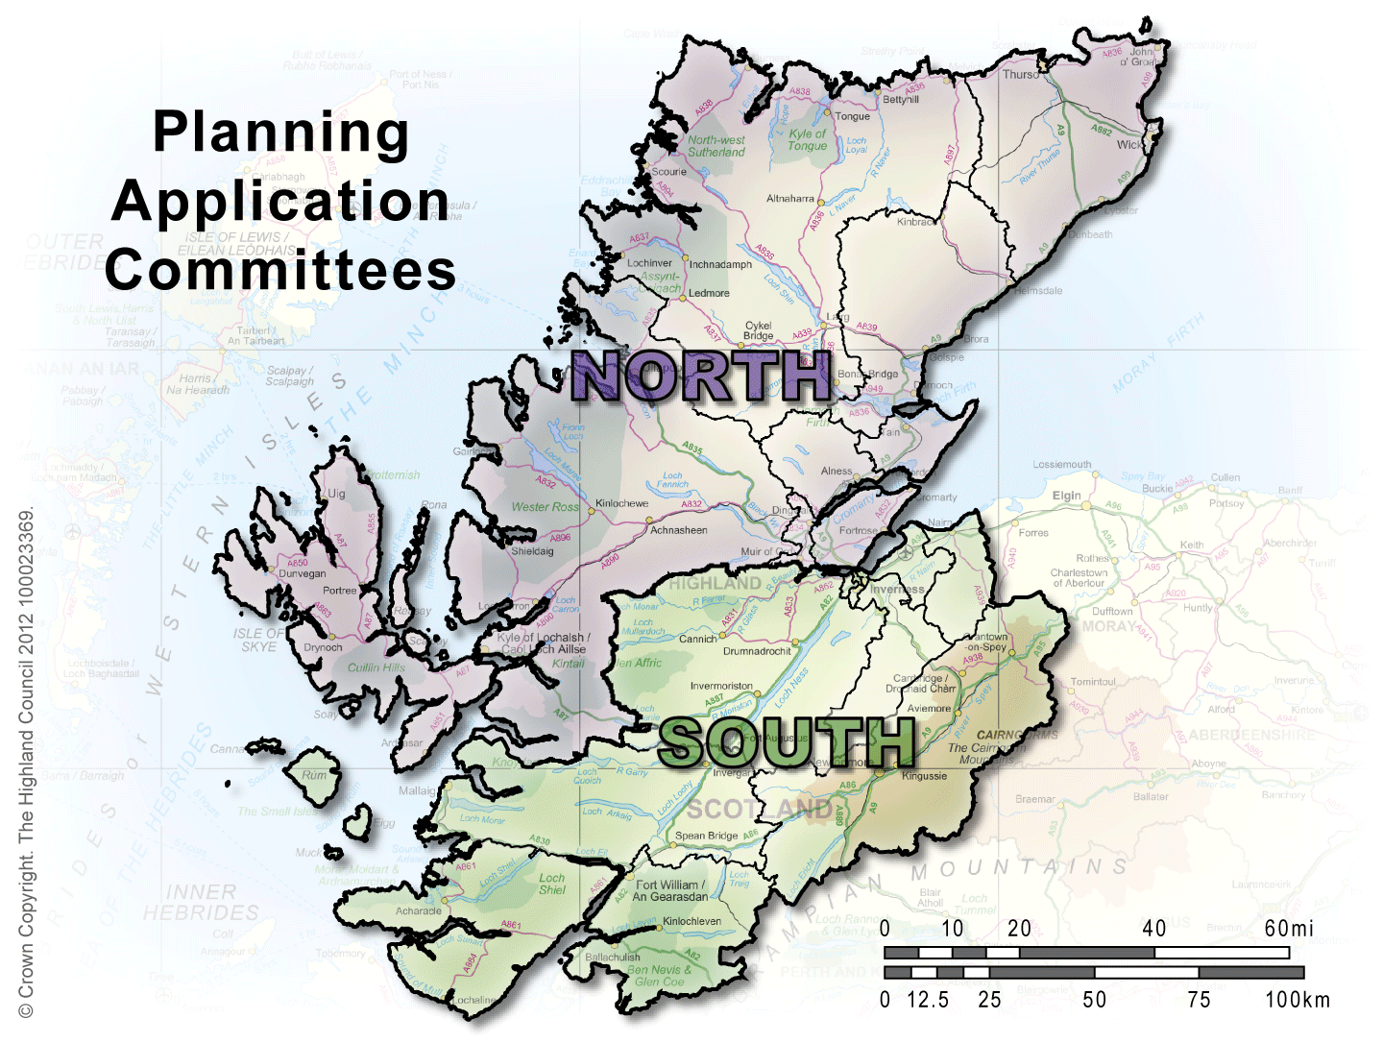
Scheme of Delegation
North and South Planning Applications Committees decide on the majority of applications
The I&E Committee deals with Notices of Amendment or other strategic planning applications (for example those with cross-boundary issues).
National applications go to Full Council.
There is a substitute member for each ward.
Notes:
Local member votes – Standing Order 13.2. Must be a site within (or at least partly within) the member’s ward. Practice is to email your LMV request to the Committee Clerk, Admin Officer and Chairman and to copy it to the Assistant Chief Executive. This must be done by no later than 5 pm on the day before the meeting. (See Additional Materialspage 1)
Very small proportion of applications dealt with by committee. In 2011 – of the 3483 applications determined by the Authority, only 208 were determined by Committee, the remainder being determined by officers under delegated powers. (See details at Item 6 of Mock Agenda).
To determine all applications referred to the Committee (with the exception of applications relating to ‘major developments’ (as designated by s26A(1)(b)and 2 of the Town and Country Planning (Scotland) Act 1997 (as amended) which are considered to be significantly contrary to the development plan, rather than to a Planning Applications Committee where the Director, following consultation with the Planning, Environment and Development Chair and the relevant Chairs of the Planning Applications Committees, is of the opinion that an application raises strategic and/or cross boundary issues
19. To determine applications referred to the Committee under the Council's Notice of Amendment procedures in respect of applications first considered at a Planning Applications Committee.

Slide 15
Before Committee
Papers will be circulated electronically initially
Full pack will follow
Email is sent to advise which applications are coming up in your ward
Opportunity to consider and if needed discus with the officers for clarification
Please discuss with clerk or officer if you are seeking clarification regarding mitigation, the use of condition or possible motions
Don’t leave it to the last minute or the day of the meeting
Notes:
74% of local pre-apps issued within 6 weeks and 100% of major development pre-applications within 4 weeks

Slide 16
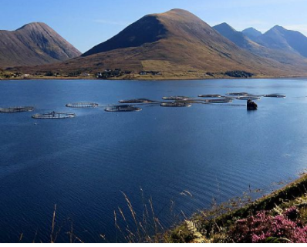
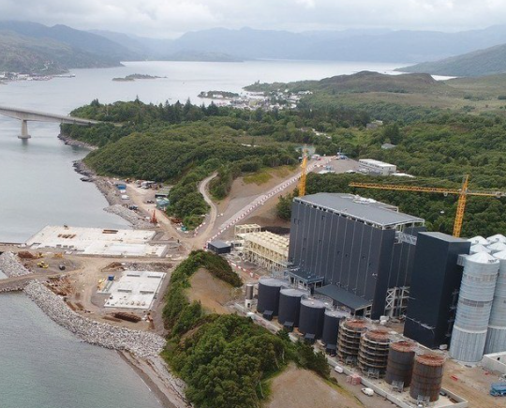
Aquaculture
Determining Planning applications
    Freshwater Fish Farming
    Marine Fish Farming
Forward Planning for Aquaculture
    Aquaculture Framework Plans
    Coastal Plans
    Marine Spatial Plans

Slide 17
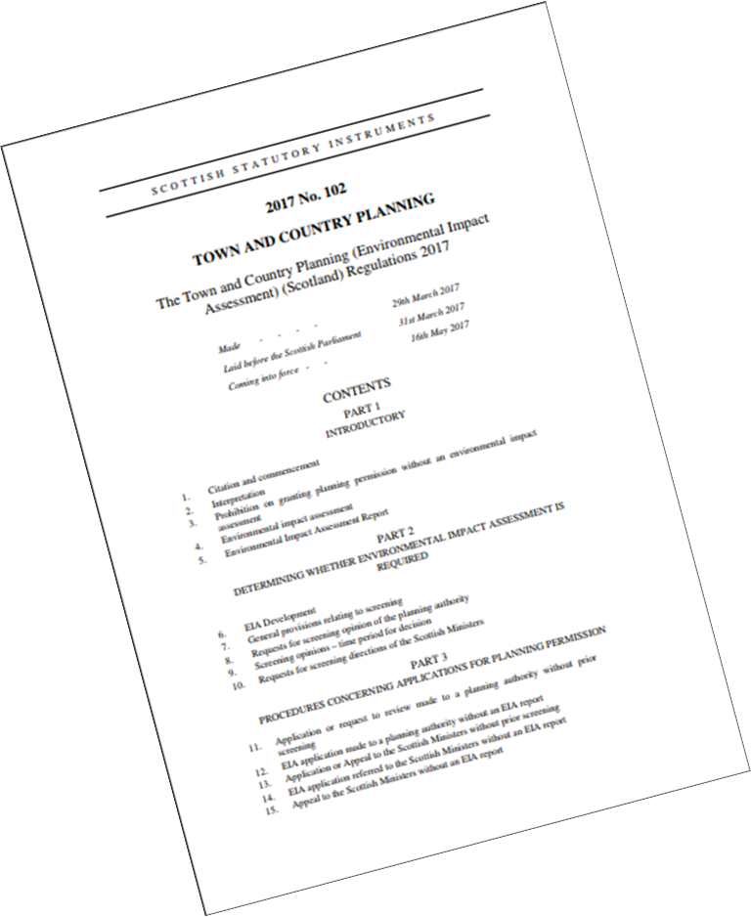
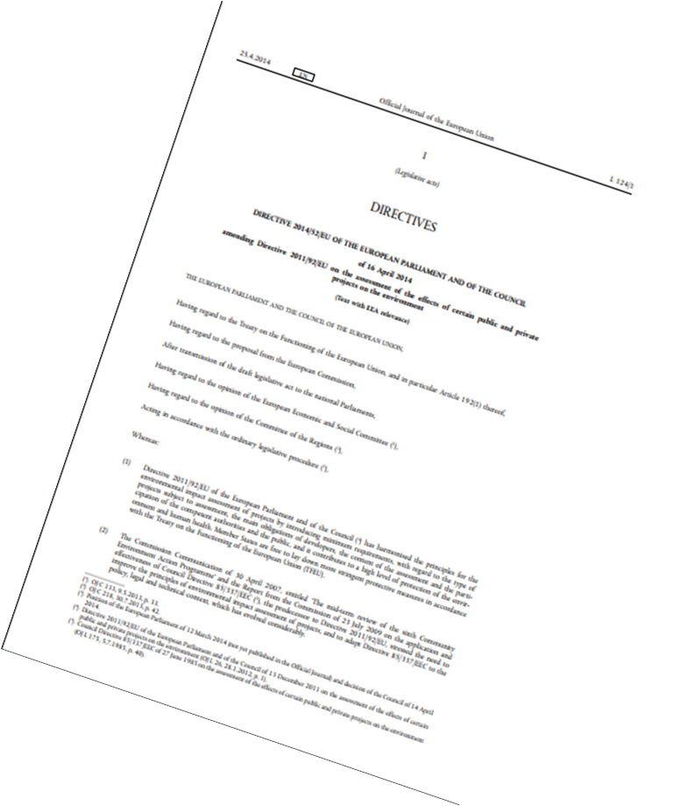

EIA
Environmental Impact Assessment
Notes:
EIA stands for Environmental Impact Assessment. It originates from EC Directive 85/337/EEC that came into force since 1985.
The main aim of the EIA Directive is to ensure that the authority granting consent (the ‘competent authority’) for a particular project makes its decision in full knowledge of any likely significant effects on the environment.
The Directive sets out a procedure that must be followed for certain types of project before they can be given ‘development consent’.
The first Regulations came into effect in 1988.
For us it is how it is applied to planning applications that is most relevant, but similar Regulations exist for Electricity Works, Roads, Marine Licensing etc…
There is a legal duty to consider the likely significant effects on the environment.
We do this firstly by Screening a development. If it is EIA then we would undertake to provide a Scoping response. An Environmental Statement would be required to accompany the application and for this to be fully assessed in coming to a decision.

Slide 18
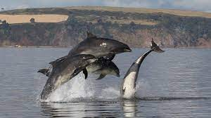
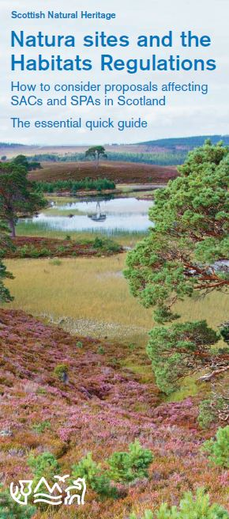

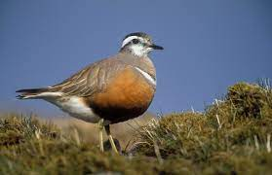

Habitats Regulations
Notes:
The Habitats Regulations cover the requirements for:
• protecting sites that are internationally important for threatened habitats and species – i.e. European sites
• a legal framework for species requiring strict protection – i.e. European protected species
This places a duty on the Council, as a competent authority, to ensure that development proposals do not have an adverse impact on a European site. This is sometimes referred to a Natura site. Where a development has a relationship to the site that may impact on its integrity the Council is required to undertake what is known as an appropriate assessment. This is generally contained as an appendix to Reports.
It is not possible to make a decision on an application, to either approve or refuse, until sufficient information has been presented in order to come to an appropriate assessment. The Council will generally rely on the advice of NatureScot to do this.
The Council is also required to ensure that consideration is given to the protection of European Protected Species before a decision is made on a development that may impact on them.
In addition to this, legislation and policy will require us to take into account all protected species and our biodiversity more generally.

Slide 19
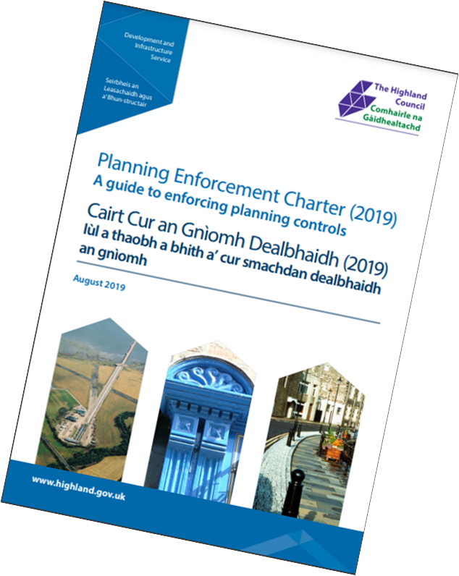
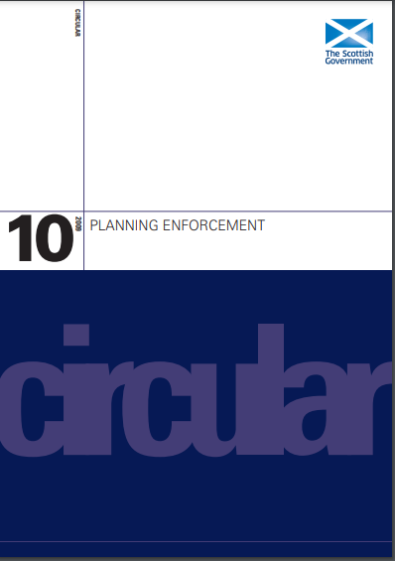
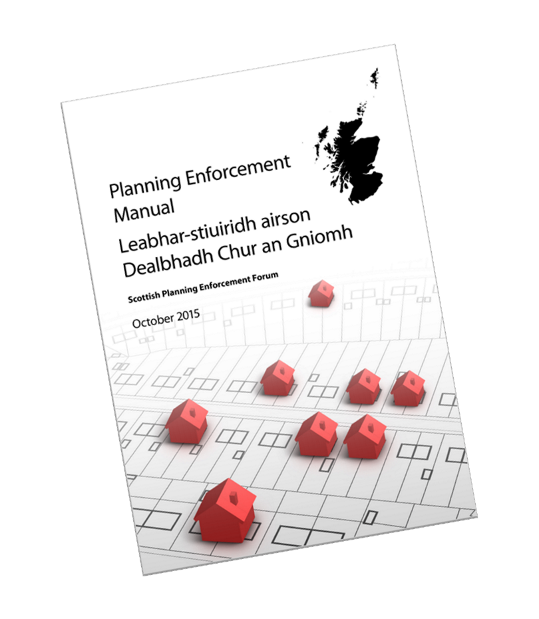
Enforcement
Notes:
There are a number of powers available to remedy a breach of planning control, whether related to unauthorised development and/or activity, non-compliance with conditions or general amenity considerations.
First thing to remember however is that it is not an offence not to obtain planning permission.
It is in relation to listed building consent, conservation area consent and advertisement consent.
We have powers to enter land, to serve notice on owners/occupiers and, where necessary to take Direct Action. There is also scope to consider prosecution. However, our approach to regularising development is heavily influenced by Government guidance and national advice. This informs our Charter.
This requires us to take action that is proportionate to the nature of the breach, always acting in the public interest. In the majority of cases, this will be resolved through informal negotiation. Only the most significant breaches are likely to result in service of a notice.

Slide 20
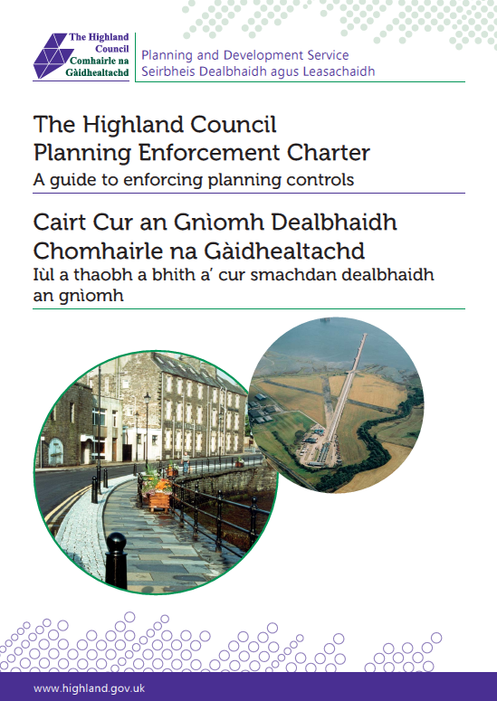
Planning Enforcement
New powers and responsibilities under the Planning Act - Higher fees for Retrospective applications
Planning Enforcement Charter – reviewed every 2 years
Team of 3
546 enforcement cases opened 381 enforced cases pursued
50 notices served.

Slide 21
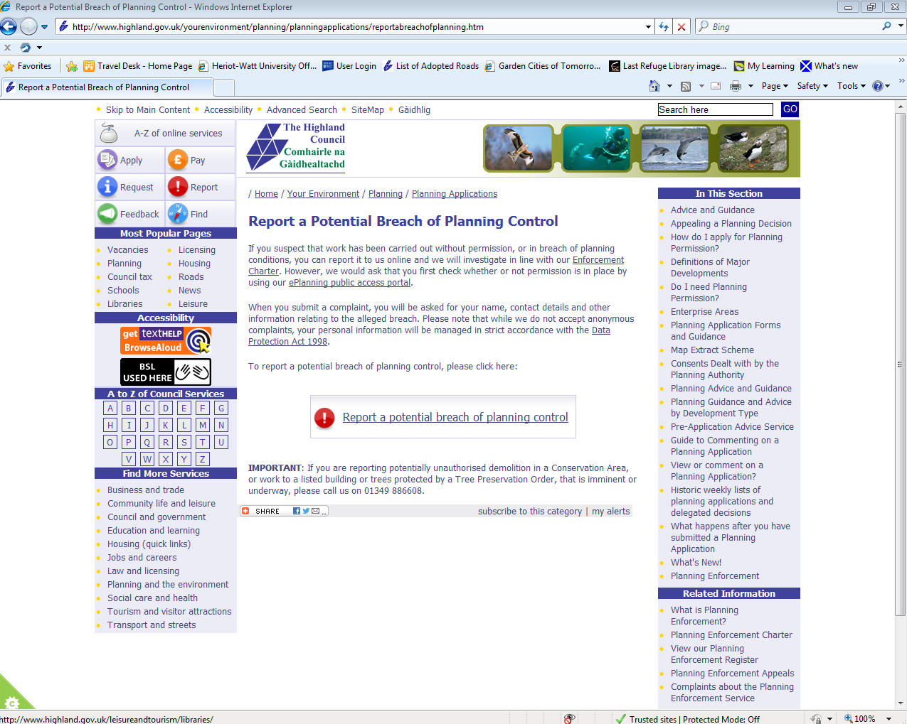
Reporting a Breach of Planning Control
An eForm for reporting potential breaches of planning control.
It has been modelled on other corporate forms and is straightforward to use.
This is the preferred method of contact regarding a potential breach as it allows us to track and monitor all alleged breaches.
If computer or internet access is an issue the Service Centre will complete the form over the telephone.

Slide 22
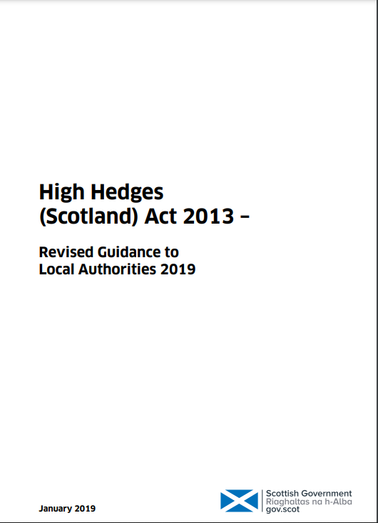

High Hedges
High Hedges (Scotland) Act 2013
Guidance
Online form
Notes:
Not specifically a planning issue but one that we deal with.
Maximum of a dozen cases a year – evenly split on average between north and south

Slide 23
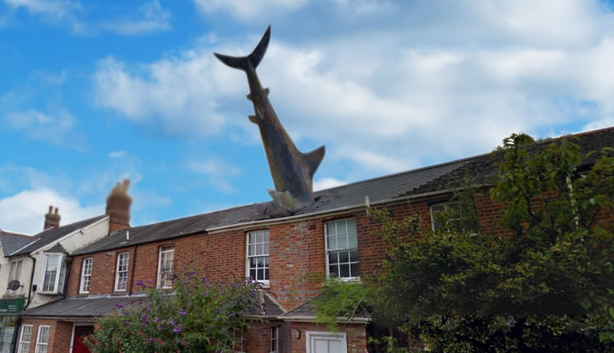
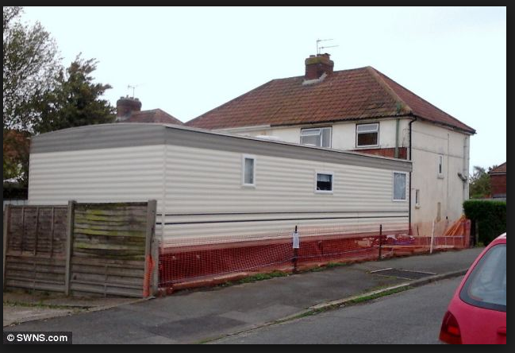

Slide 24
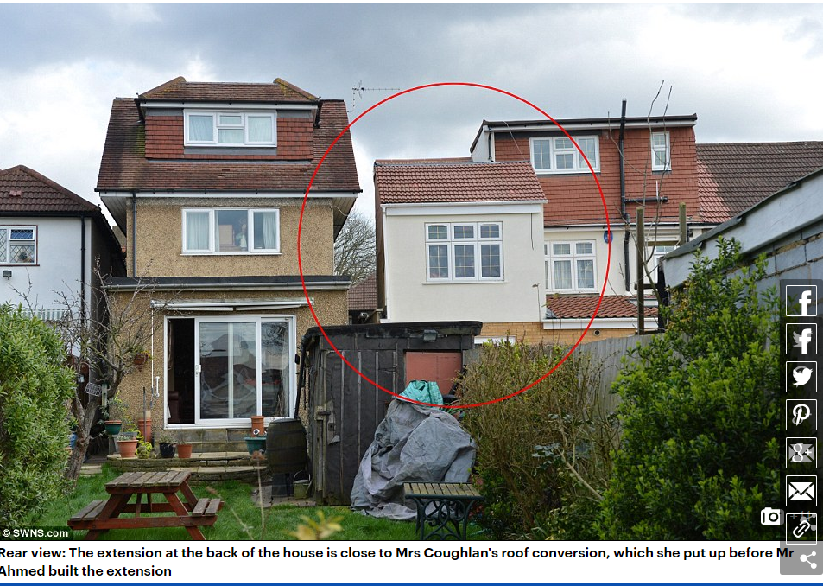
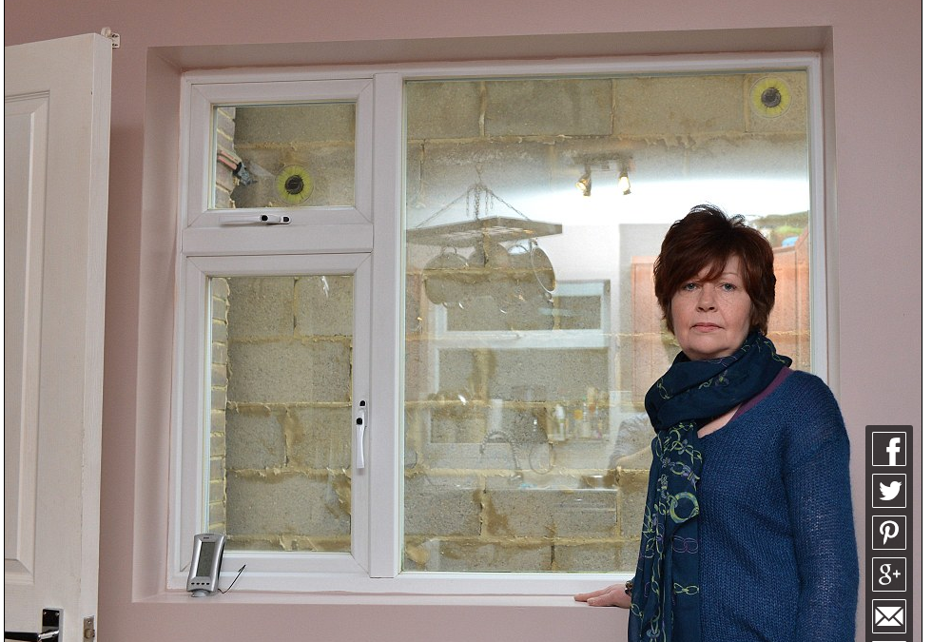

Slide 25
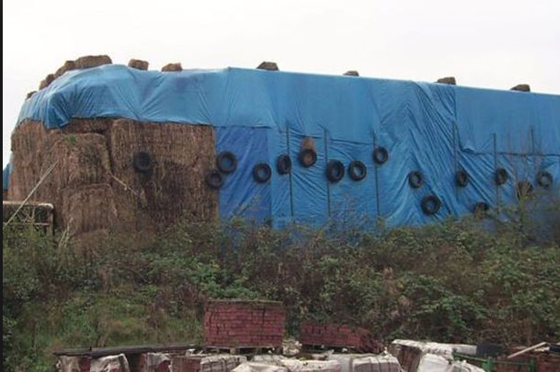
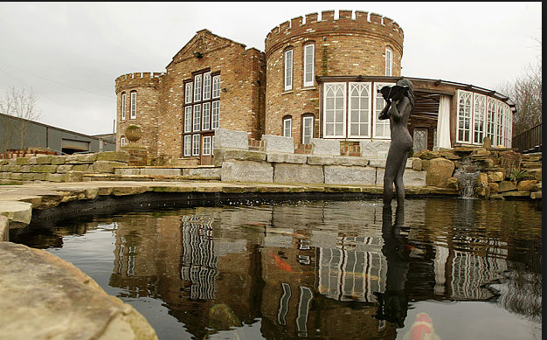

Slide 26

Questions

