Slide 1
Member Presentation – 24th May 2022
Economic Development Service
  Economy and Regeneration
    Business development
    Business Gateway
    Employability
    Tourism and Inward Investment
    community regeneration
    Strategic Growth
  Housing development
  Property Estates

Slide 2
Economy and Regeneration
Economy and Regeneration
Business Development
Business Gateway
Employability
Community Regeneration
Strategic Growth
Tourism and Inward Investment

Slide 3



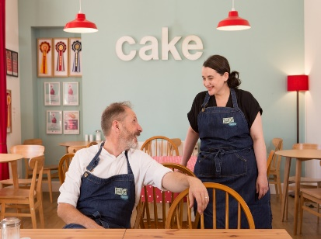
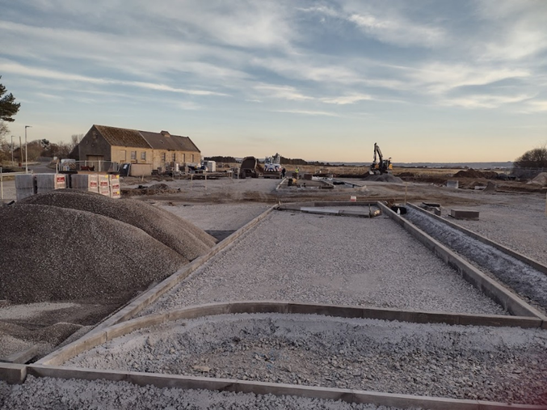
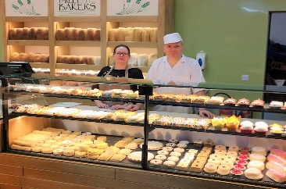
Business Development
HOIL: Last 5 yrs. £1.7m invested, levering £6.65m
CLF: New - £1m for community businesses
Small Loans: New £240k
£1.25m grant programme for new & growing businesses
Covid-19 Business Grants: £200m, 5000+ businesses
Community Loan Fund
Start-up and Growth grants
Small Loans Scheme

Slide 4

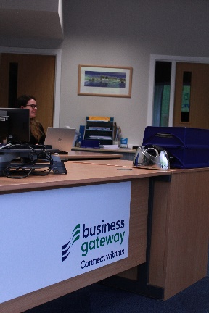


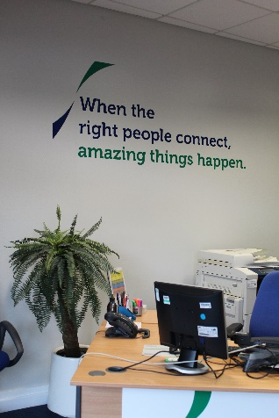
Start-ups: 1:1, bus. plans, grant support, workshops (250+ per year)
Growing businesses: grant support, 1:1; detailed growth plans (232 in 21/22)
Team of 7 advisers with contracted specialists
Workshops/ webinar attendees, 1321 in 21/22.
Digital Boost: 1:1 specialist support, webinars, podcasts. 549 workshop attendees in 21/22.
Start-up advice and support
1:1 Advisory Support
Growing business advice and support
Online resources, webinars and workshops

Slide 5
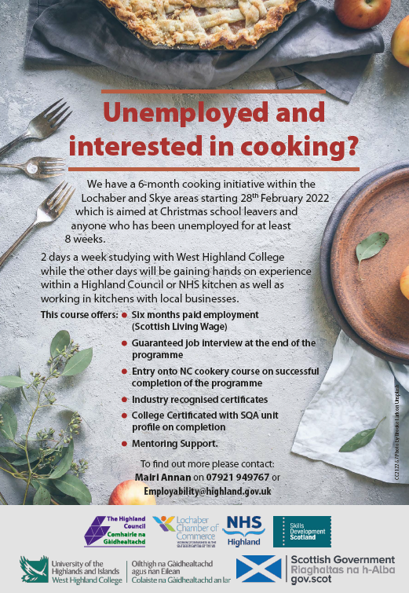
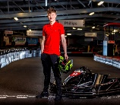
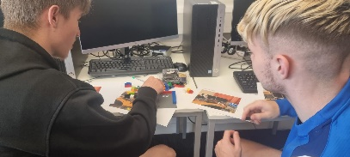

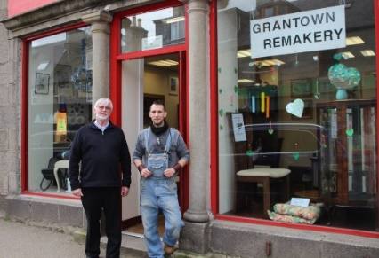
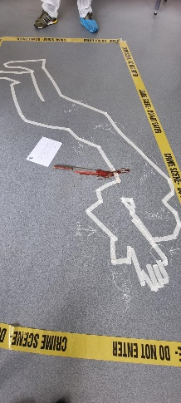
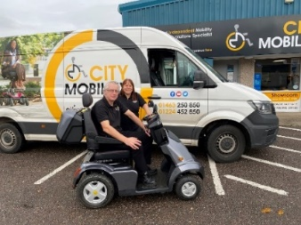
Employability
580 clients in 21/22 (growing post-pandemic)
In-house and contracted key worker team
271 clients in 21/22 into work/ work placements
HERO – since launch in March’21, 317 recruits
New partner service delivery approach (NOLB)
Key worker advice and support
HERO - Employers Incentive
Paid Work Placements
Highland Employability Service
Contracted client services, activities and courses

Slide 6
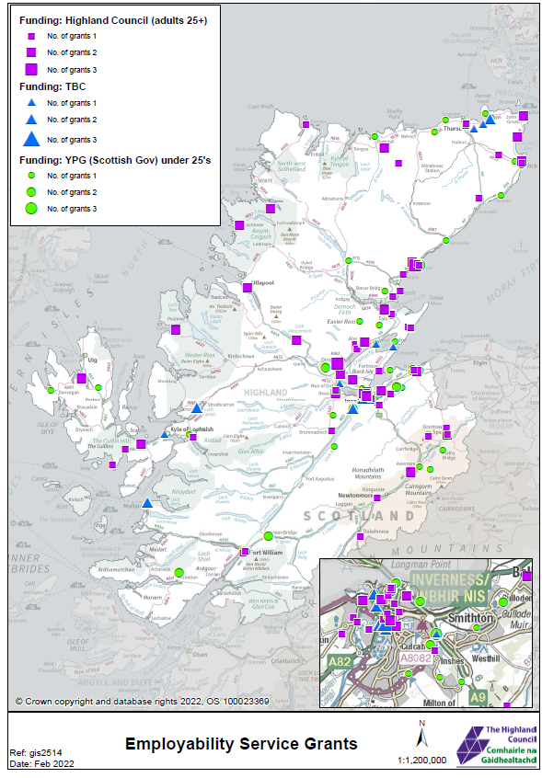
HighlandEmploymentRecruitmentOffer

Slide 7
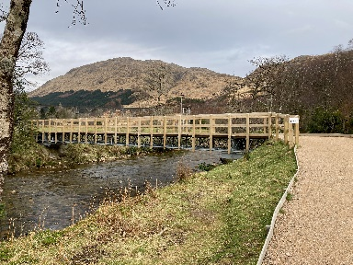

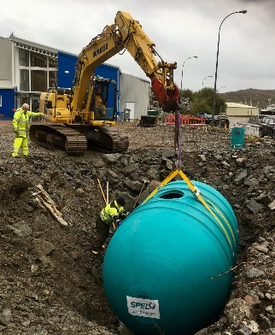

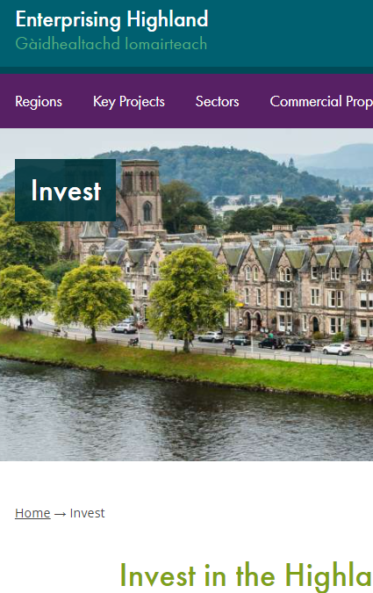

Tourism & Inward Investment
£1.4bn/ 25,000 fte
RTIF: 30 projects/ £5.2m
Work via 8 business led DMO’s
190 film enquires yr/£1m production spend
UCI World Cup: 20,000 crew/ spectators, global media reach
“Live, work, visit and invest”
Tourism support and strategic infra.
Events
Area Promotion
Talent Attraction
Film

Slide 8
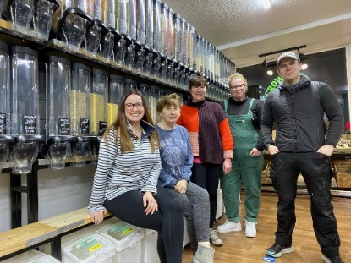
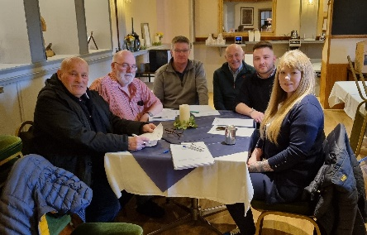
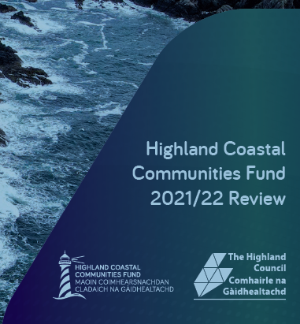
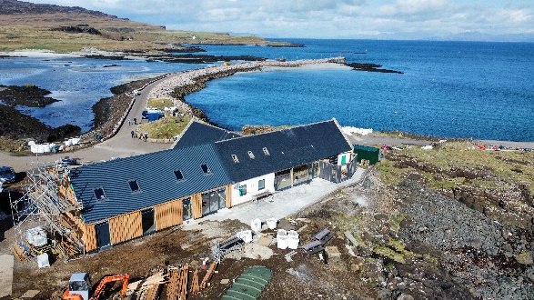
Community Regeneration
Helping people to come together, to plan and take collective action to improve their communities
Engagement, planning and project development
Project and grant management
Progress, measurement and reporting
Project assessment and decision-making
Over 180 ‘live’ projects
Some £11m plus across 10 grant programmes
Aspiration to move to multi fund, multi annual allocations
Local decision-making and place-based plans

Slide 9
Strategic Growth
Completion of EU funding programmes
Levelling Up Fund: 1 approved, 3 to be submitted
Shared Prosperity Fund: Investment Plan
Ongoing delivery of approved City Region Deal projects
Strategic: e.g. Scotwind/Ports and Harbours; Hydrogen; Net Zero skills and business opps.
SCA: collaboration opportunities with other Scot. cities
Strategic Projects
City Region Deal

Slide 10
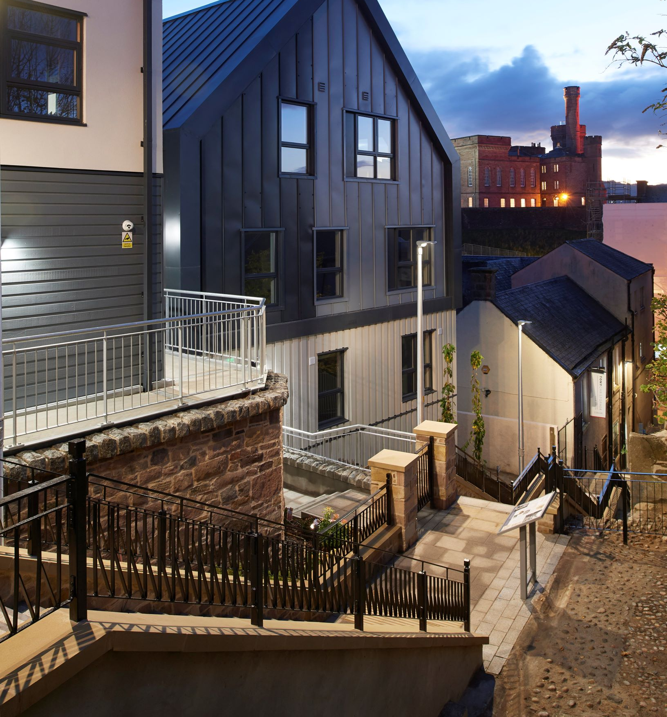
Housing
Development

Slide 11
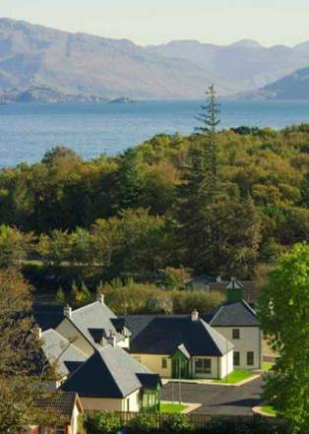
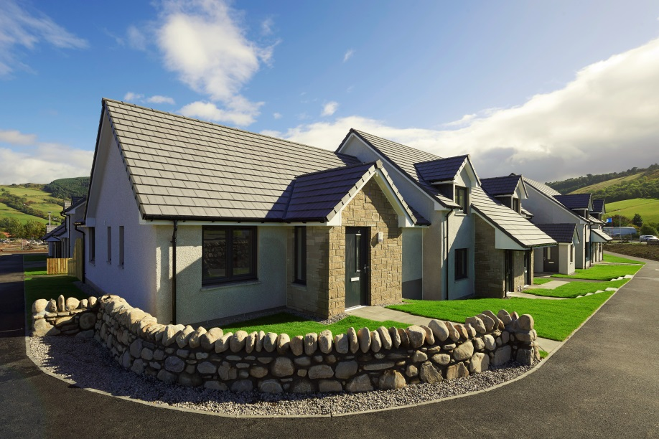
Highland Council Strategic Housing role
Housing Needs & demands assessment
Local housing Strategy
Strategic Housing investment Plan
Delivery of Scottish govt affordable housing targets with partners

Slide 12
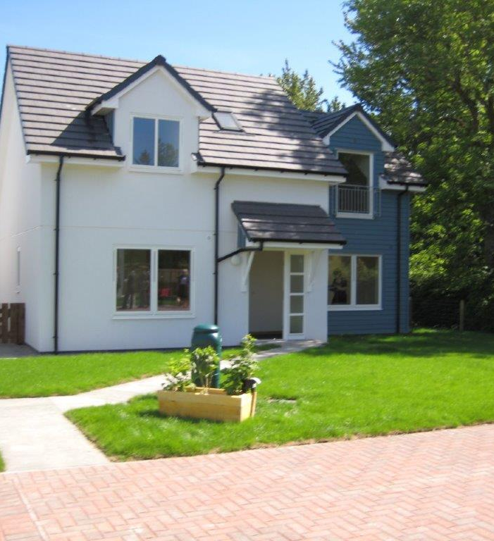
HUB Partners
Highland Council
Scottish Government
Scottish Water, SEPA etc
Housing Associations
  Albyn HS
  Cairn HA
  Lochalsh & Skye HA
  Lochaber HA
  Caledonia HA
  Other Nationals RSLs
Community Housing Trust
Highland Housing Alliance
Community Groups

Slide 13
Scottish Government
Investment Levels in Highland

Slide 14
Funding Affordable homes
for 2015-2021 programme
Total Cost £ 145,000
Capitalised rent £ 70,000
Scottish Government subsidy £ 60,000
      Land bank subsidy £ 15,000
For 2021-26 programme
Total Cost £175,000
Capitalised rent £ 70,000
Scottish Government subsidy £ 90,000
      Land bank subsidy £ 15,000
  However some projects cost over £250,000 cost per unit

Slide 15
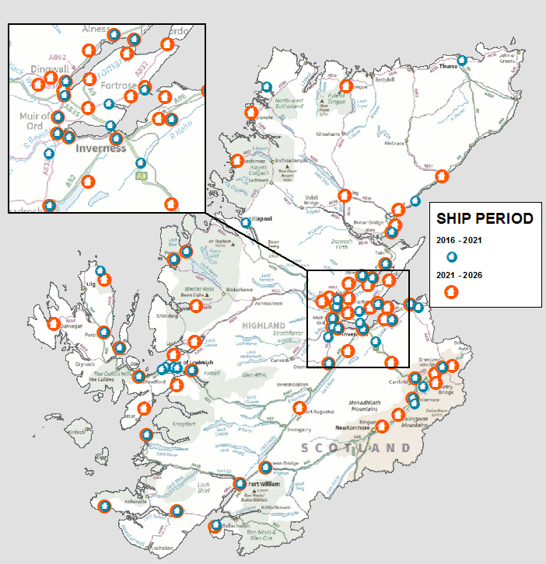
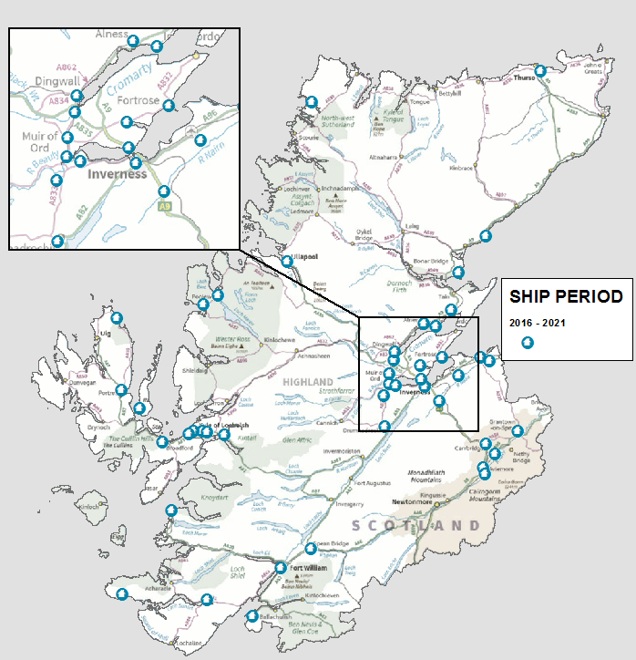
Affordable
Homes for the
Highlands
2016 – 2026

Slide 16
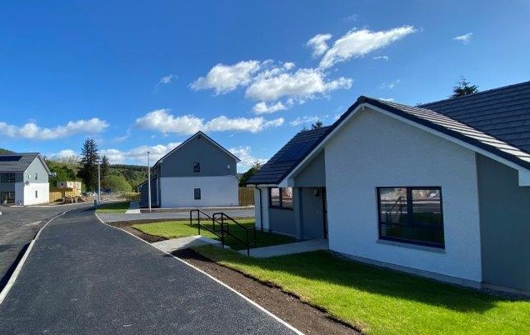
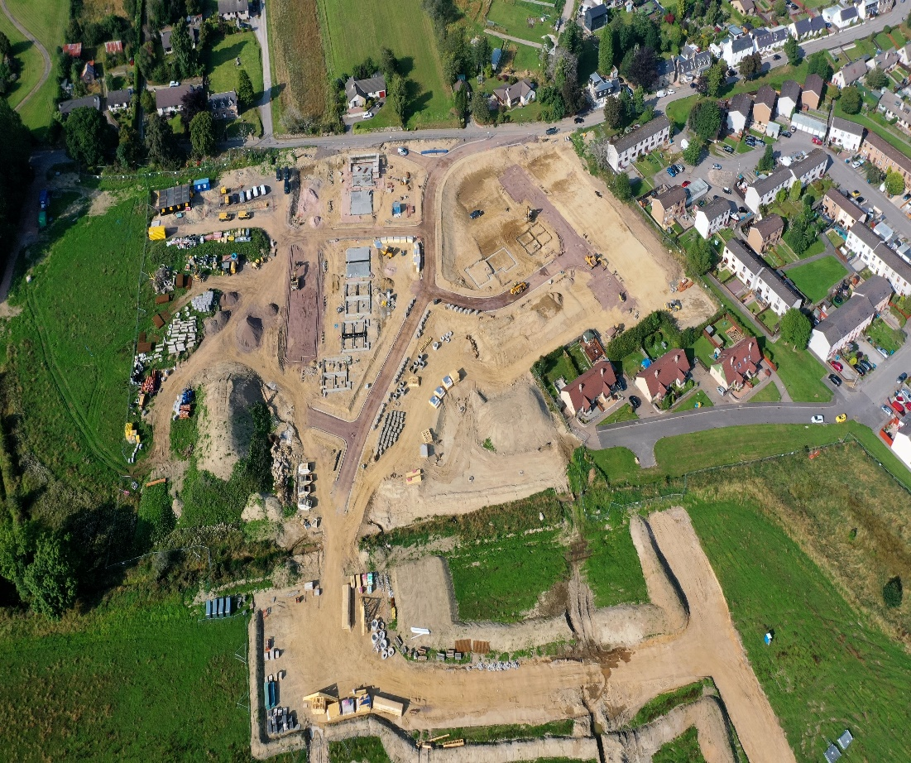
Housing development
Evanton
Granton on Spey

Slide 17
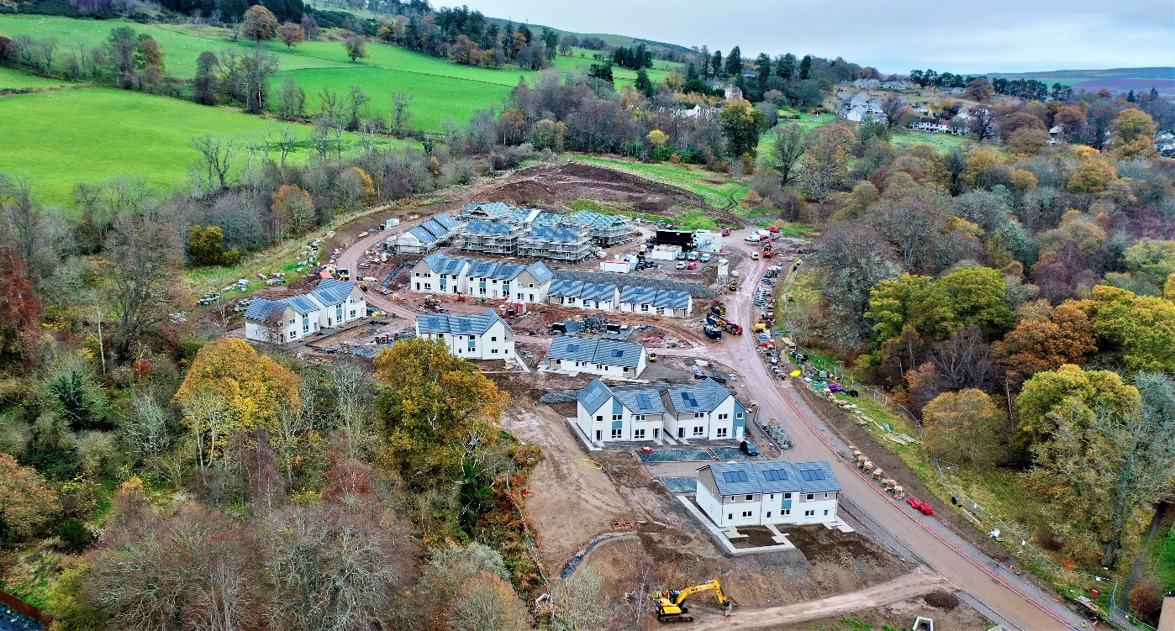
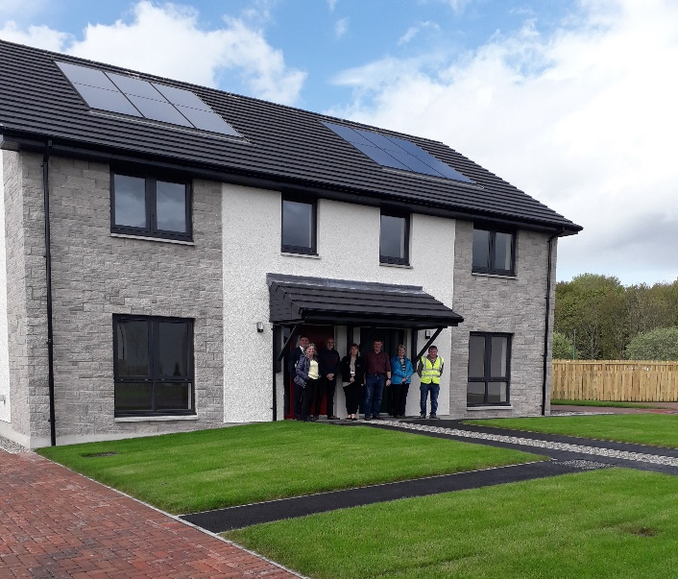
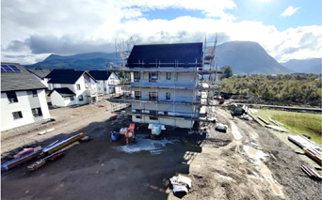
Housng Development
Dingwall North
Dornoch
Blar Mor
Fort William

Slide 18
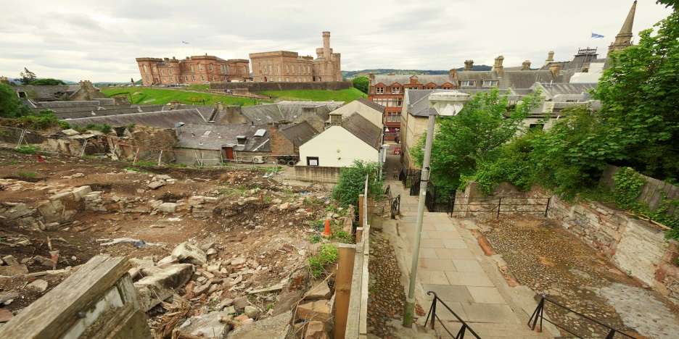

finished product ..
As was….
Raining Stairs

Slide 19
Property Estates
Manage 750 commercial properties
Mainly Ground leases, industrial units & retail units but also offices , caravan parks agricultural land
Generating approx. £6.5m revenue income
  £4million general account
  £2.3 million Inverness common good
  + HRA and other common good accounts
build new industrial units , starter units enabling economic growth and development
Team provides valuation advice to other services
Deals with all purchases , sales and lease and rental negotiations

